Slide 1
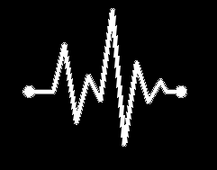
When do I need to obtain an ECG as a Psychiatrist?
Rohul Amin MD, DFAPA, FACP
Assoc Professor of Psychiatry and Medicine

Slide 2
Disclaimer
The content of this workshop and associated trifold card and cases and all other materials, is provided for reference and educational purposes only. The content is not meant to be complete or exhaustive or to be applicable to any specific individual's medical condition.
Medical information changes and so does medical practice. This workshop contains health or medically related materials that are up-to-date at the time of the workshop but we assume no duty to update this in the future.
This workshop is not an attempt to practice medicine or provide specific medical advice for an individual patient, and the information contained in it should not be used to make a diagnosis or to replace or overrule a qualified health care provider's judgment. The content in this workshop is not intended to be a substitute for professional medical advice, diagnosis or treatment.

Slide 3
Access the tools at:
https://www.holisticaremd.com/ecg

Slide 4
Let’s start with a Vignette
40 year-old male with history of hyperlipidemia and venous insufficiency complicated by leg ulcers, who has anxiety symptoms. Otherwise healthy and active.
Current Medications: Atorvastatin 40mg daily, Furosemide 20mg daily, Vitamin B12 1000mcg daily.
Previously trialed on various SSRI’s and SNRI’s but has had best response to citalopram.
You want to start him on one of the following:
  A: Citalopram
  B: Sertraline
  C: Amitriptyline (to also target his neuropathic pain)
  D: Venlafaxine
In which of the 4 scenarios (if any) should you consider a baseline ECG?
Notes:
Who thinks it’s a, B, C, D?

Slide 5
Back to the Vignette
40 year-old man with history of hyperlipidemia and venous insufficiency related ulcerations has anxiety symptoms. Otherwise healthy and active.
Current Medications: Atorvastatin 40mg daily, Furosemide 20mg daily, Vitamin B12 1000mcg daily.
You want to start him on one of the following:
  A: Citalopram → Yes, if tends to get hypokalemic (ensure normal electrolytes)
  B: Sertraline → No
  C: Amitriptyline (to also target his neuropathic pain) → Yes, if tends to get hypokalemic
  D: Venlafaxine → No

Slide 6
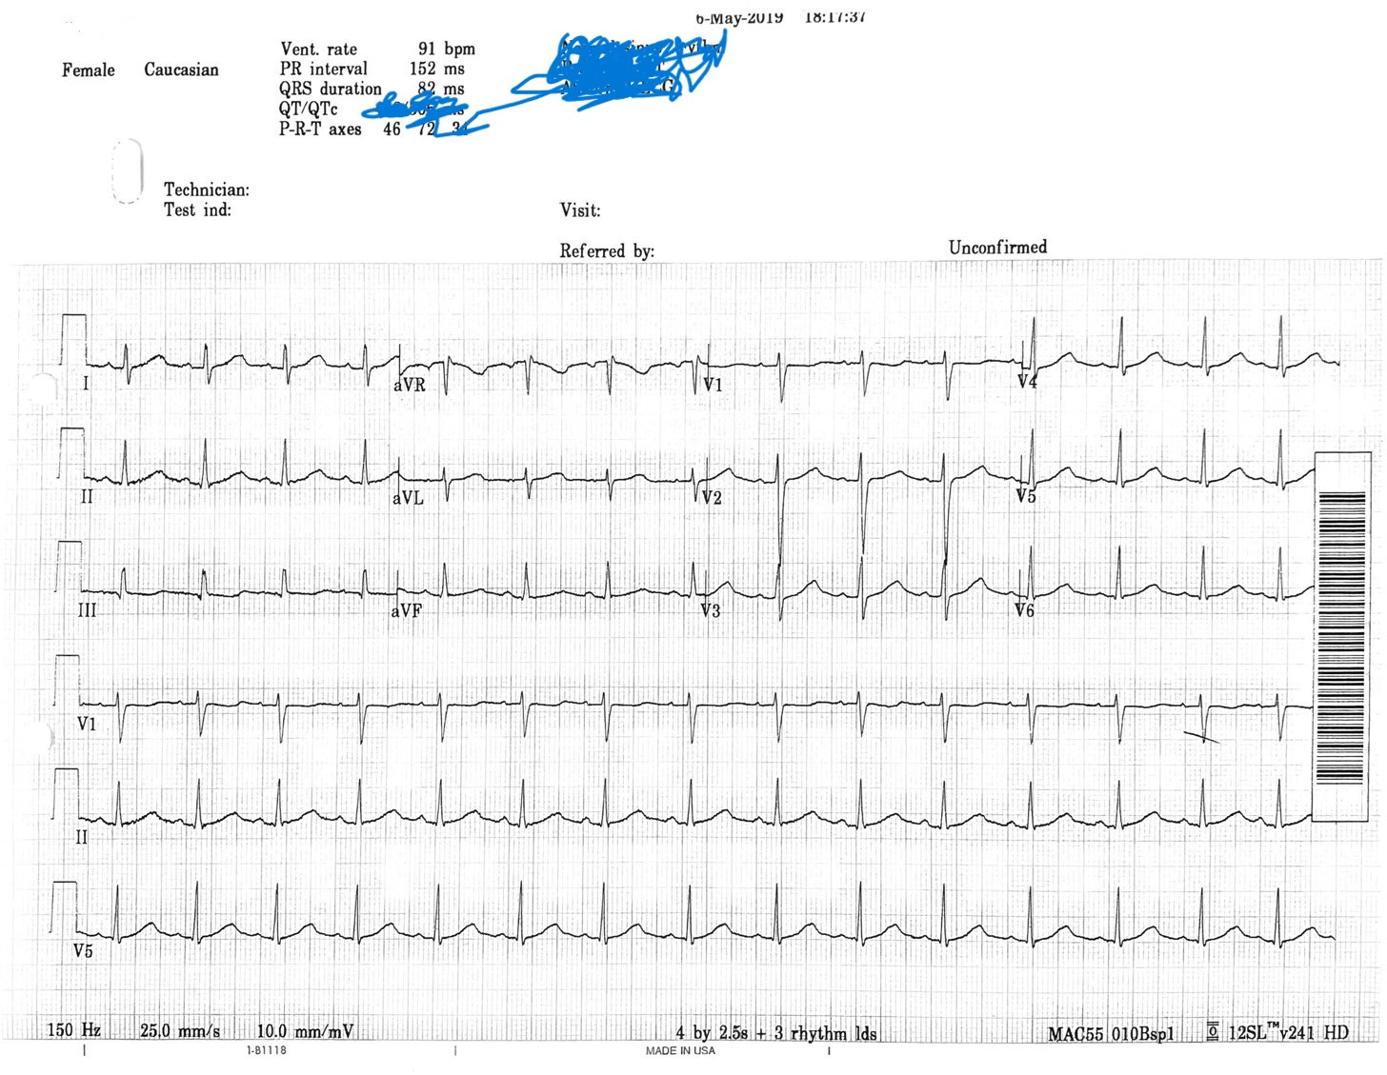
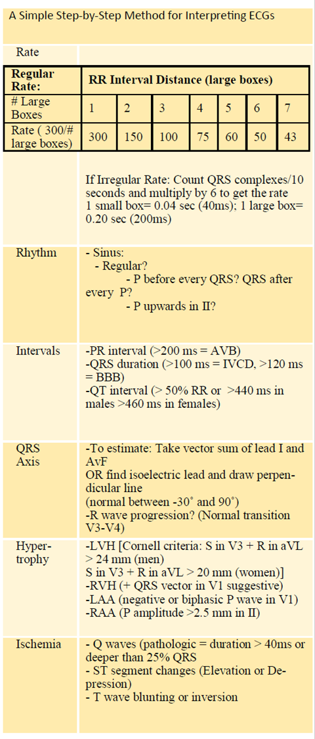

Slide 7
Why Bother Knowing this?
Associated Mortality
Screening everyone isn’t realistic or cost-effective
Our skills to interpret diminish overtime

Slide 8
Events per 1000 patient-years
Clozapine-Induced Agranulocytosis | Sudden Cardiac Death in patients taking antipsychotics
0.2 Events | 2.9 Events
Schneeweiss S, Avorn J: Antipsychotic agents and sudden cardiac
death: how should we manage the risk? N Engl J Med 2009;
360:294–296
Alvir JM, Lieberman JA, Safferman AZ, Schwimmer JL, Schaaf JA:
Clozapine-induced agranulocytosis: incidence and risk factors in
the United States. N Engl J Med 1993; 329:162–167

Slide 9
Inpatient Psychiatric Population
6790 inpatients/5 years
Drug induced Long QT in 62 (0.9%)
  Increased hypokalemia, Hep C, HIV
  Haloperidol, sertindole, clotiapine, phenothiazines, fluoxetine, citalopram (including escitalopram), and methadone were significantly more frequent
  After controlling for several factors: haloperidol, clotiapine, phenothiazines, and citalopram (including escitalopram) remained statistically significant
27.3% with some form of abnormality on ECG
Sudden Cardiac Death: 5 patients (7 other with TdP) – This equates to 73/100,000 persons-year!
86% with 2+ factors
Am J Psychiatry 2013; 170:1468–1476)
Notes:
This study illustrates Long QT occurs in inpatient psychiatric unit but there are always other factors on top of exposure to psychotropics. Diligence in modifying some of these risk factors is the basis of why we wanted to do this workshop.

Slide 10
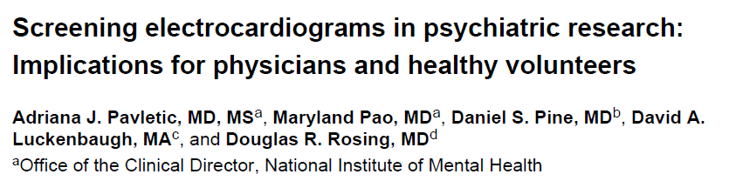
500 ECG’s from 405 subjects (95 with GAD or Social Anxiety)
22.4% abnormal or borderline
1.6% (8): echocardiograms done (all normal)
Conclusion: false positive = unintended consequences
Notes:
So given what we talked about, should we screen everyone? Here’s the issue: we will end up with potentially harming folks--- distress of positive results, cost, and other invasive procedures may result. Hence we have to find the right population to target for screening.

Slide 11

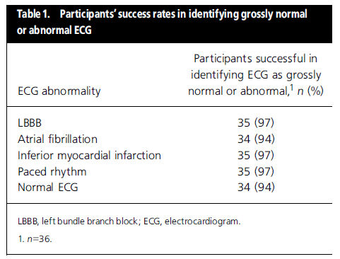
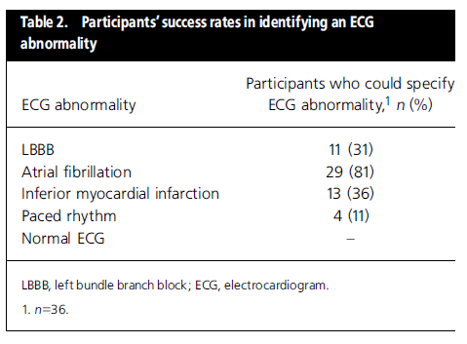
Notes:
Most psychiatrists might be good at knowing gross “normal” or “abnormal” EKG--- but unable to go to the next step and identify specific findings (other than Afib).

Slide 12
Iatrogenic Mortality Here = Torsades de Pointes (TdP) → Sudden Death
Could we predict those at risk to avoid this associated concern?
  Drug Type
  Family and Personal Risk Factors
  Pharmacological considerations
  Physiochemical considerations
  ECG (QTc prolongation)
Drug
QTc Prolongation
Torsades de Pointes
Ventricular Fibrillation
Sudden Cardiac Death
Patient Risk Factors
Notes:
So to clarify the problem again--- or what we want to achieve today. We want to avoid these chain of events. The cartoon here shows the Yellow Ribbons--- this is what we want to focus on--- figure out which drug and which patient-specific risk factors ought to help us screen for QT prolongation. Additionally, we want to increase your confidence level.

Slide 13
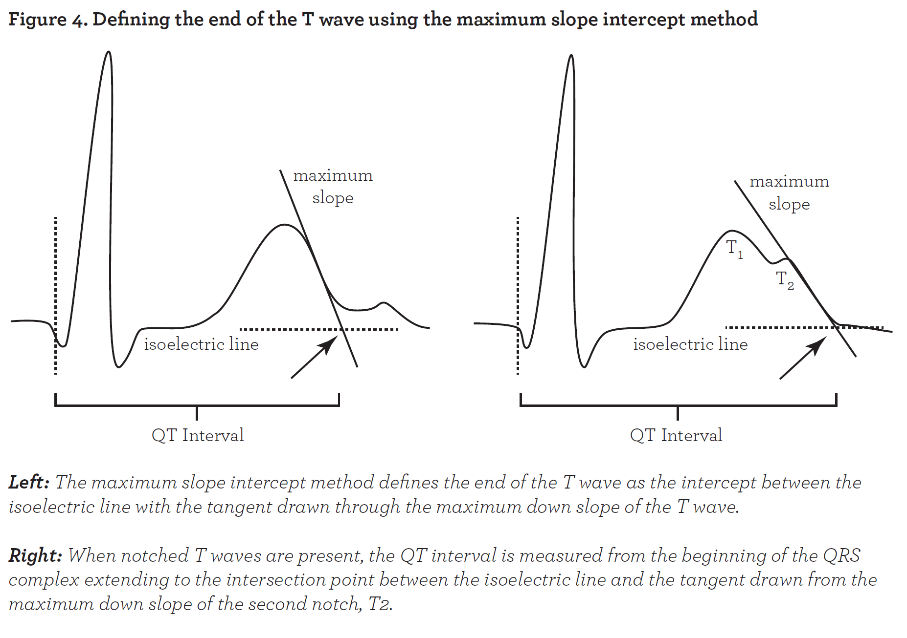
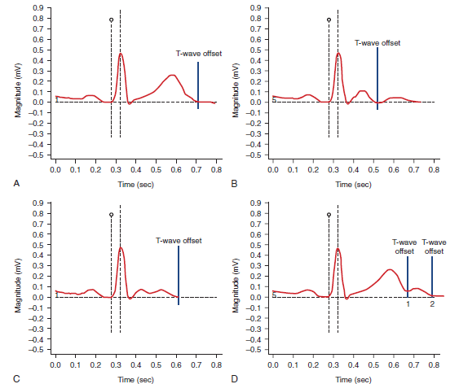
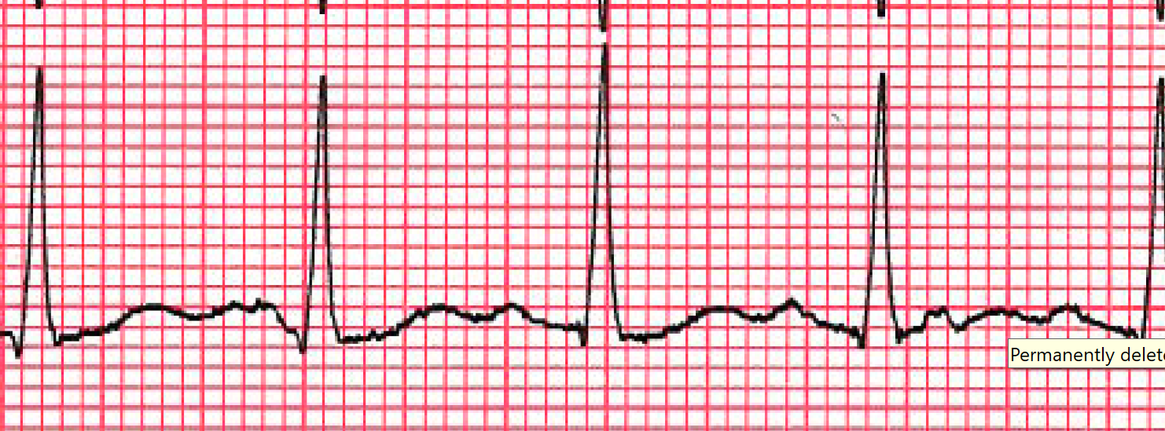
Some challenges to measuring QT/QTc
A. Normal T Wave
B. T wave with U wave
C. Biphasic T wave
D. U vs. T2 wave
From Goldenberg I, Moss AJ, Zareba W: QT interval: How to measure it and what is “normal,” J Cardiovasc Electrophysiol 17:333–336, 2006.)
Notes:
Here are some of the technical challenges. The morphology of the T Wave can pose a significant challenge. Obviously automatic machine measurements can be thrown off by these. This is why we want you to learn to manually do this especially if the T Wave morphology is challenging one.

Slide 14
Low level skills needed for QTc evaluation: Automated calculated QTc likely good enough
Automated QTc interval (418 +/- 22 ms) Vs. Manual QTc interval (419 +/- 23 ms) were similar (n = 155, r = 0.8, p 0.0001)
In 51 patients who had the QTc interval calculated both by the internal Medicine physician and by the automated ECG machine, a correlation coefficient of r = 0.997, P < 0.0005 was found.
From Martell BA, Arnsten JH, Krantz MJ, Gourevitch MN. Impact of methadone
treatment on cardiac repolarization and conduction in opioid users. Am J
Cardiol. 2005;95:915-8.
From Peles E, Bodner G, Kreek MJ, Rados V, Adelson M. Corrected-QT intervals as related to methadone dose and serum level in methadone maintenance treatment (MMT) patients: a cross-sectional study. Addiction. 2007;102:289-300.
Notes:
The automatic reading is pretty good in most cases.

Slide 15
QTc Prolongation is valuable to assess for TdP and SCD.
Each 10-ms increase in QTc contributes approximately a 5% to 7% exponential increase in risk for TdP (congenital QT prolongation)
QTc 500 ms is associated with a 2- to 3-fold higher risk for TdP
Moss AJ, Schwartz PJ, Crampton RS, et al: The long QT syndrome. Prospective longitudinal study of 328 families. Circulation 1991; 84: pp. 1136-1144
Notes:
Despite those challenges with QT… it’s still the best thing we have available and is value added based on these associations.

Slide 16
Risk of TdP Significant for QTc>500 ms
On-Therapy QTc (ms) | Incidence of TdP | Change Baseline (ms) | Incidence of TdP
<500 | 1.3%(1787) | <65 | 1.6% (1516)
500-525 | 3.4%(236) | 65-80 | 3.2% (158)
525-550 | 5.6%(125) | 80-100 | 4.1% (146)
>550 | 10.8%(157) | 100-130 | 5.2% (115)
( ) # patients assessed |  | >130 | 7.1% (99)
From BETAPACE®(sotalol hydrochloride) Package Insert- Berlex Laboratories 2001
Notes:
Here’s climbing risk fo TdP with rising QTc in patients with sotalol. 92% of TdP occur when QTc is greater than 500.

Slide 17
Recap
QTc, TdP and SCD related issue a big cause of drugs taken off market
A “cannot miss” concern
QTc is one imperfect surrogate marker but the best we’ve got for predicting Sudden Cardiac Death.
  Specific areas to consider:
    Drug dose/serum level
    Personal factors (heart rate, sex, genes etc)
    Specific Drug Factors
Screening everyone not feasible

Slide 18
Caution on the Algorithm
NOT necessarily “evidence-based” as most guidelines are expert opinions
  Caution-based
Serve as a cognitive checklist
  Addresses only most situations but not all…
Not prospectively studied or validated
US centric (with secondary input from UK guidelines)

Slide 19
QTc Prolongation Risk Factors Worsen with Age
Risk of QTc Prolongation Amplified
  Pre-existing cardiovascular disease
  Female Sex
  Electrolyte abnormalities
  Thyroid Disease
  Structural Brain Disease
  Co-administration other QTc prolonging medications
  Acute Hepatic Failure
Age
Notes:
Random cut offs are used in various guidelines. We think it’s best to consider specific risk factors instead.

Slide 20
Unrealistic Recommendations
“For elders, TCAs and oral MAOIs are often best initiated in the inpatient setting so that important parameters such as blood pressure, orthostatic blood pressure and pulse, and electrocardiogram (ECG) can be optimally monitored.”
“Frequency of follow-up visits during the initial stages of outpatient treatment is determined by the individual situation, but typically should be every 1–2 weeks. At steady state, the TCA blood level and a follow-up ECG should be obtained.”
Jacobson, Sandra A. Clinical manual of geriatric psychopharmacology. Washington, DC: American Psychiatric Association, 2014. Print.
Notes:
This is what the current recommendations you might find if you crack open some of the books dealing with Geriatric psychopharmacologist. It’s unclear how they come up with these very unrealistic recommendations. For example, who would do inpatient hospitalization for a TCA in an elderly patient while risking all the issues related to hospitalizing someone i.e. delirium, C.difficile infection, and not to mention the cost.

Slide 21
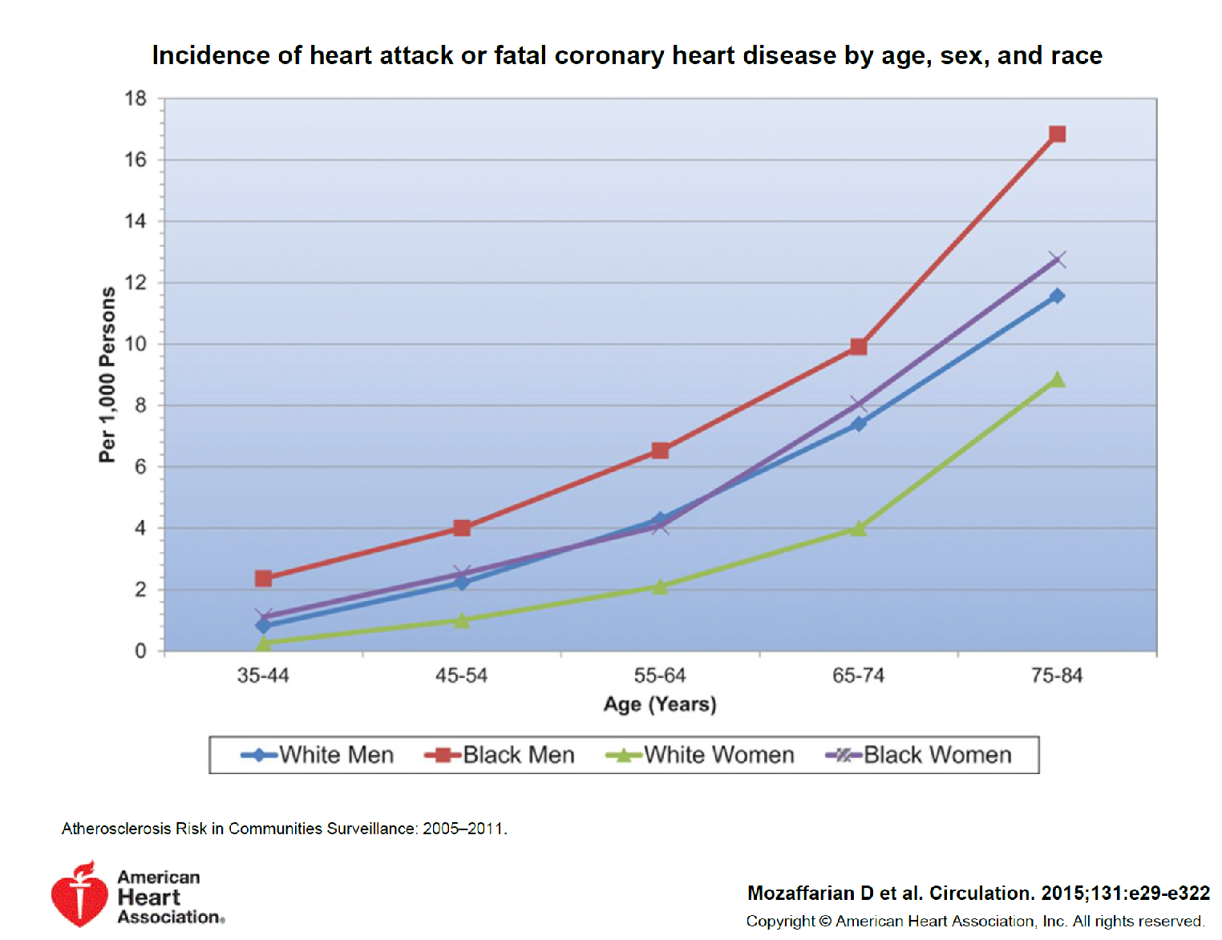
Notes:
Let’s think of age as a marker for underlying risk factors. Two of those risk factors on the algorithm are structural heart disease and arrhythmia. Myocardial infracts can lead to scaring of the myocardium and could be a risk for both of these. This graph shows relative ages at which men and women have increase in the incidence of MI and death. Obviously race is a big factor with Black men and women having much higher risk. It takes off sharply for Black women after age 55 while the rest of the groups in their 60’s.
The risk is even more complicated. Next Slide

Slide 22
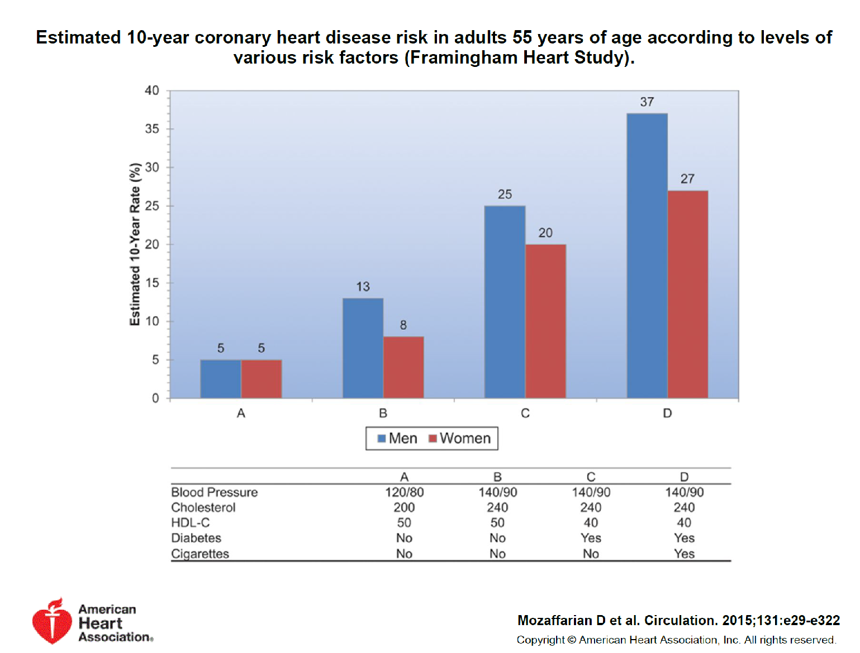
Notes:
It’s not just the age but what other risk factors are present. It’s the same 55 yo man and woman but various risk factors with a difference of 8-fold between Man A and Man D.
So, age is just a small part of the story. This is why the algorithm focuses on the actual individual risk factors. Those obviously increase with age.
Let’s talk specifically about age and QTc next.

Slide 23

ECG Case
Let’s go over that ECG together
The patient on furosemide had tendencies for hypokalemia but was non-adherent to potassium supplements
He wants to go back on citalopram

Slide 24
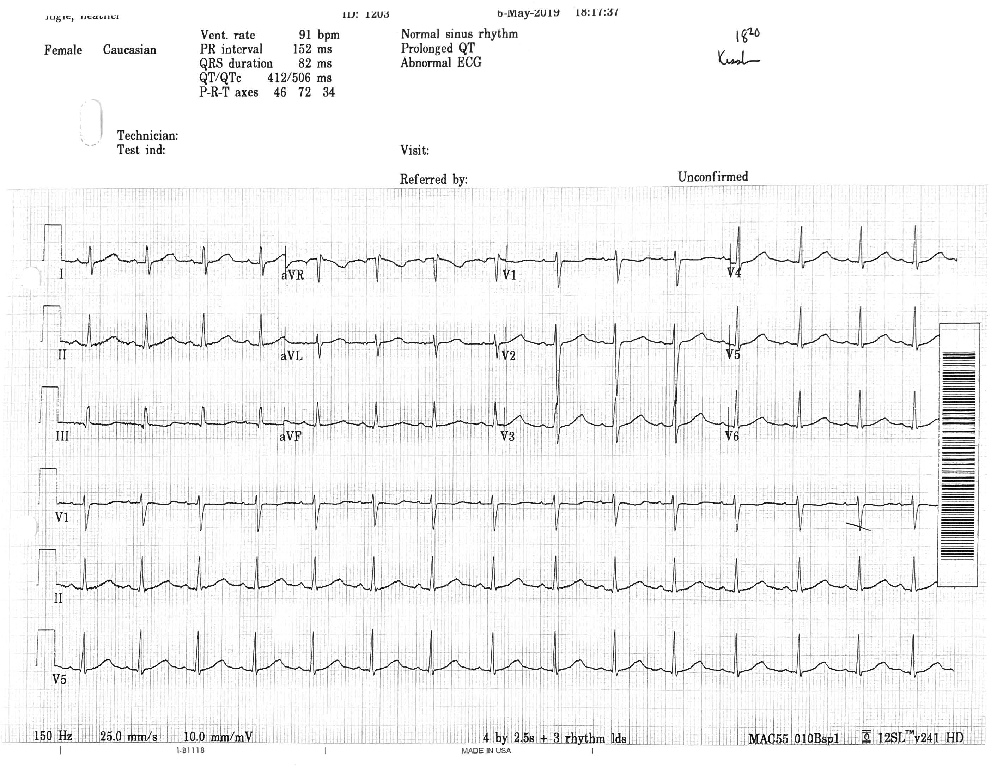
Case 1

Slide 25
A Simple Step-by-Step Method for Interpreting ECGs
Be systematic
  Rate
  Rhythm
  Intervals
  QRS Axis
  Presence of Hypertrophy
  Signs of Ischemia

Slide 26
What’s the rate?
Method #1
1
2
3
4
5
6
7
8
9
10
11
12
13
14
15
1. Count total number of beats in rhythm strip
2. Multiple by 6
15 x 6 = 90 bpm

Slide 27

What’s the rate?
Method #2
Count big boxes to estimate rate
1 2 3 4 5 6
300 - 150 - 100 - 75 - 60 - 50
1
2
3
3 + “a little” $≅$ 90

Slide 28
A Simple Step-by-Step Method for Interpreting ECGs
Be systematic
  Rate
  Rhythm
  Intervals
  QRS Axis
  Presence of Hypertrophy
  Signs of Ischemia

Slide 29
What’s the rhythm?
Determine if sinus rhythm
  P upright in lead II

Slide 30
What’s the rhythm?
Determine if sinus rhythm
  P wave Present before every QRS complex and vice versa

Slide 31
What’s the rhythm?
Determine if sinus rhythm
  P and QRS complexes occur regularly

Slide 32
A Simple Step-by-Step Method for Interpreting ECGs
Be systematic
  Rate
  Rhythm
  Intervals
  QRS Axis
  Presence of Hypertrophy
  Signs of Ischemia

Slide 33
What are the intervals?
  # small boxes x 0.04
PR Interval
  Normal PR Interval:
    > 200 ms (1 big box) = 1 degree AVB
PR
3.5 (Small boxes) x 0.04 = 140ms

Slide 34
What are the intervals?
  # small boxes x 0.04
QRS Interval
  Normal QRS:
  >100ms (2.5 small boxes) = IV Conduction delay
  >120ms (3 small boxes)= BBB, or ventricular ectopy
QRS
2 (Small boxes) x 0.04 = 80ms

Slide 35
What are the intervals?
  # small boxes x 0.04
QT Interval
  Automated QTc probably sufficient
  >440ms in males or >460ms in Females
  Shortcut: prolonged QT if >50% of RR
QT
10 (Small boxes) x 0.04 = 400ms

Slide 36
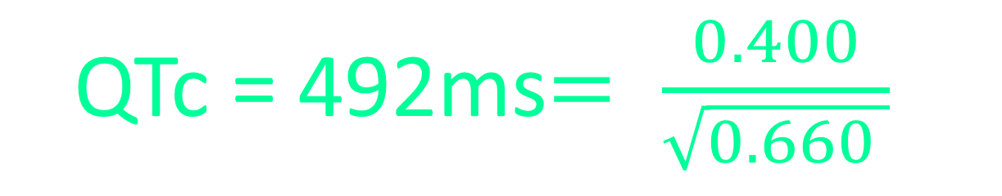
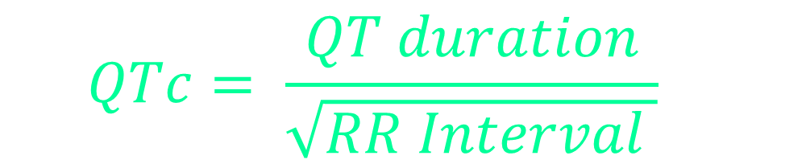
What are the intervals?
  $$QTc= \frac{QT duration}{\sqrt{RR Interval }}$$
QTc
RR
  Automated QTc probably sufficient
  >440ms in males or >460ms in Females
  Shortcut: prolonged QT if >50% of RR
QT
  QTc = 492ms$= \frac{0.400}{\sqrt{0.660 }}$

Slide 37
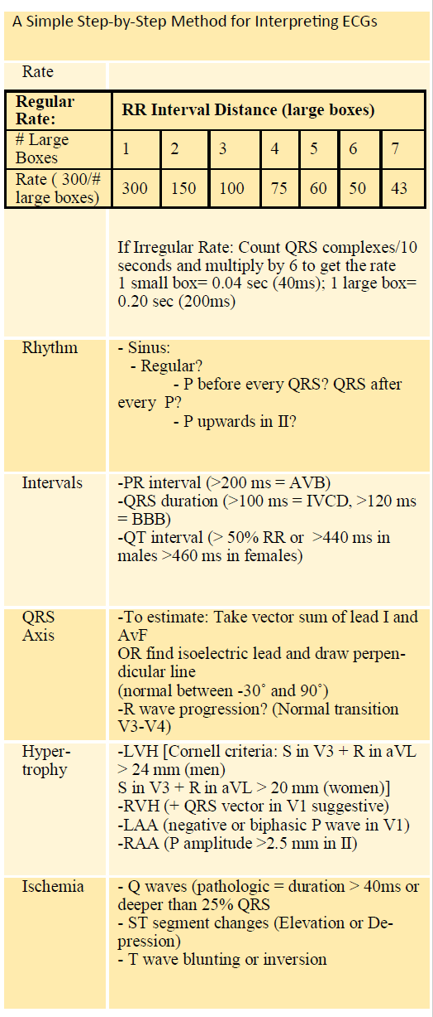
A Simple Step-by-Step Method for Interpreting ECGs
Be systematic
  Rate
  Rhythm
  Intervals
  QRS Axis
  Presence of Hypertrophy
  Signs of Ischemia

Slide 38
What’s the axis?
Lead I and aVF: Both up, different, or down?
Normal Axis

Slide 39
A Simple Step-by-Step Method for Interpreting ECGs
Be systematic
  Rate
  Rhythm
  Intervals
  QRS Axis
  Presence of Hypertrophy
  Signs of Ischemia

Slide 40
LV Hypertrophy?
    Cornell criteria:
    S in V3 + R in aVL > 24 mm (men)
    S in V3 + R in aVL > 20 mm (women)
24mm
R wave
S wave
Notes:
Probably less relevant for psychiatrists but could identify patients at risk for cardiac disease

Slide 41
RV Hypertrophy?
  (+ QRS vector in V1 suggestive)
Notes:
Probably less relevant for psychiatrists but could identify patients at risk for cardiac disease

Slide 42
Enlargement?
  LAA (negative or biphasic P wave in V1)
  RAA (P amplitude >2.5 mm in II)
Notes:
Probably less relevant for psychiatrists but could identify patients at risk for cardiac disease

Slide 43
A Simple Step-by-Step Method for Interpreting ECGs
Be systematic
  Rate
  Rhythm
  Intervals
  QRS Axis
  Presence of Hypertrophy
  Signs of Ischemia

Slide 44
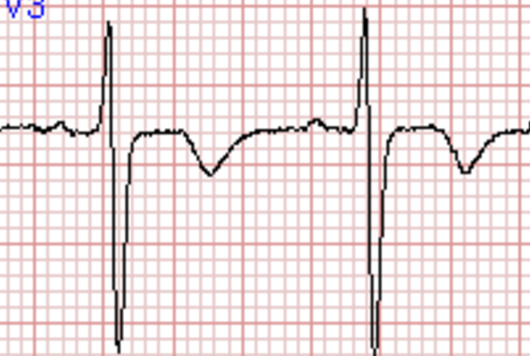
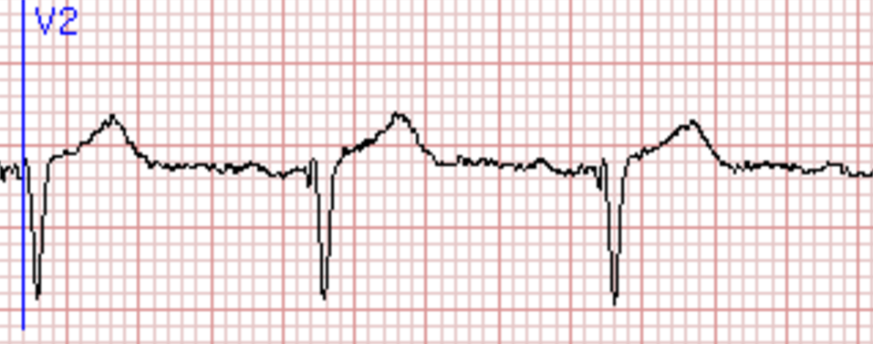
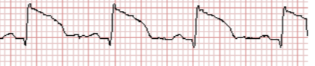
Ischemia or Infarction?
  T-wave inversion or ST depression
  Q waves
  ST segment elevation

Slide 45
  Rate: 90 bpm
  Intervals:
    PR 140ms
    QRS 80ms
    QT 400ms
    QTC 490ms +/- 20
  Axis: Normal
  Rhythm: NSR
  Long QT
  Abnormal ECG
http://images.slideplayer.com/12/3453911/slides/slide_7.jpg

Slide 46
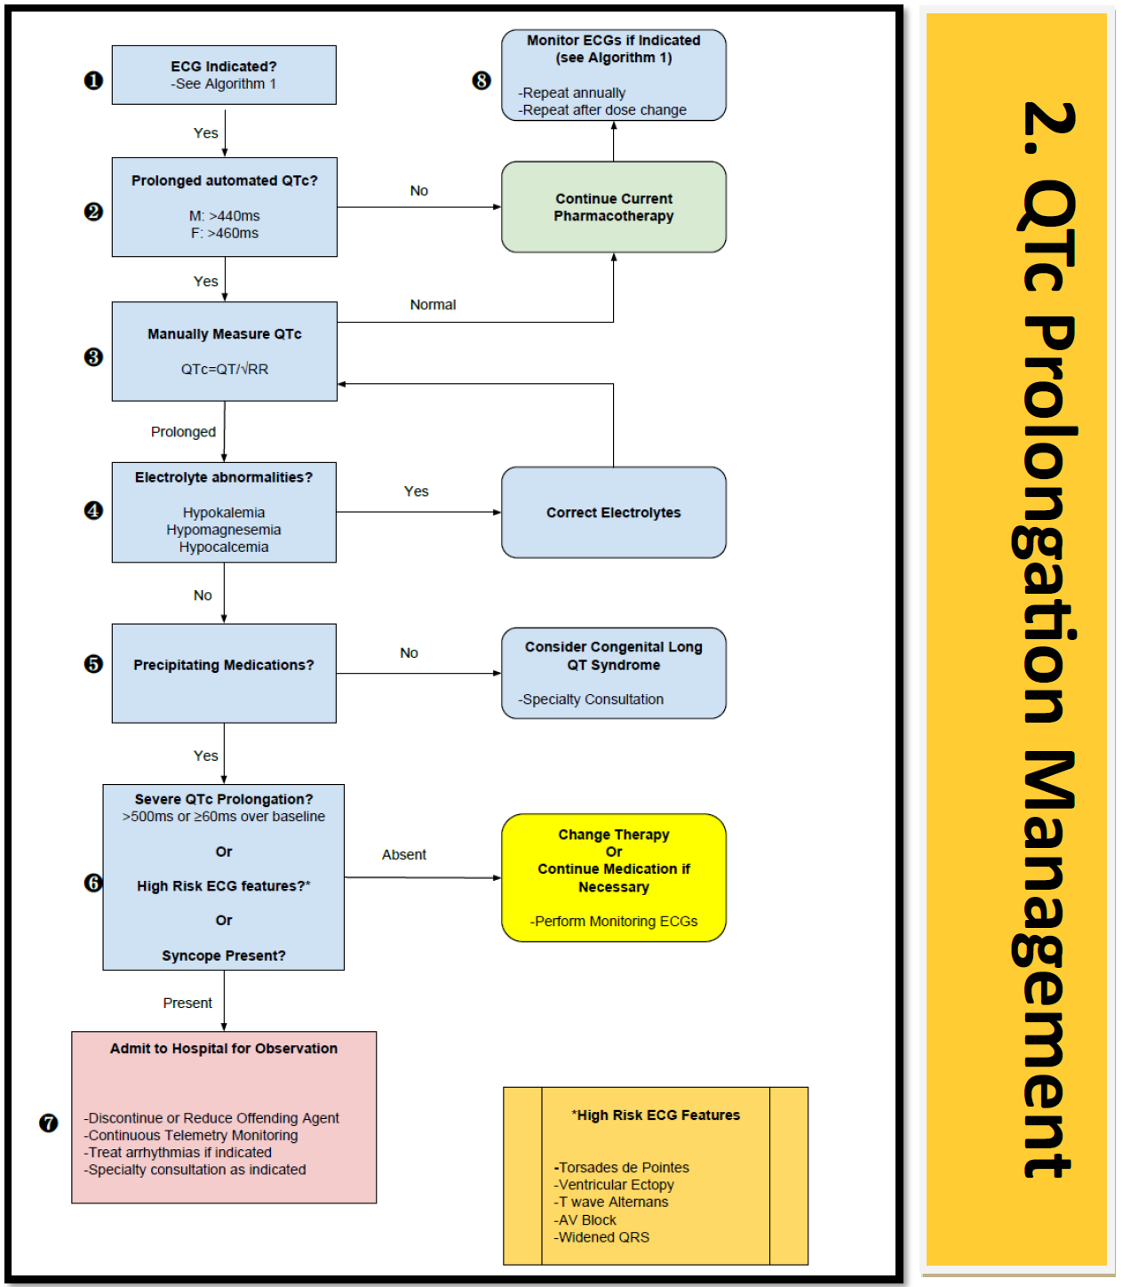

Slide 47
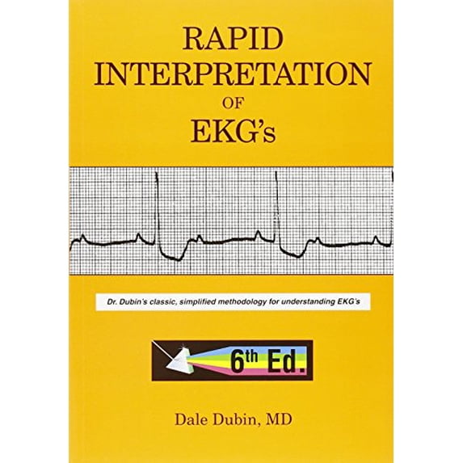
Improve ECG Skills:

Slide 48
Resources and Feedback
Algorithm Tools
https://www.holisticaremd.com/ecg
Feedback:
  Rohul.amin@usuhs.edu

