Slide 1
Evaluating and Treating ADHD in Adults
Rohul Amin MD, FACP, DFAPA
Associate Professor of Psychiatry and Medicine
Uniformed Services University of Health Sciences, School of Medicine
rohul.amin@usuhs.edu
5 April 2025 | 4:00 PM – 5:00 PM

Slide 2
Disclosure of Financial Relationships
Visit the ACP Meeting mobile app or the meeting’s web platform to view disclosure of relevant financial relationships.
Notes:
Please include this slide in your presentation and don’t make modifications to it.

Slide 3
Disclaimer
The opinions and assertions expressed herein are those of the presenter and do not reflect the official policy or position of the Uniformed Services University of the Health Sciences , United States Army or the Department of Defense.

Slide 4
Generic names for some therapeutic agents are cumbersome and not easily recognized. Some trade names may be used during this talk for the purpose of clarity. Examples are displayed below.
Generic name | Trade name
Amphetamine | Adderall, Adzenys ER, Adzenys XR-ODT, Dyanavel XR, Evekeo, Evekeo ODT, Mydayis, Zenzedi
Dexmethylphenidate | Focalin, Focalin XR
Dextroamphetamine | Dexedrine, Dexedrine Spansules, ProCentra, Xelstrym
Lisdexamfetamine | Vyvanse
Methylphenidate | Aptensio XR, Concerta, Cotempla XR-ODT, Daytrana, Jornay PM, Methylin, QuilliChew ER, Quillivant XR, Ritalin, Ritalin LA
Serdexmethylphenidate and dexmethylphenidate | Azstarys
Atomoxetine | Strattera
Guanfacine | Intuniv
Viloxazine | Qelbree
The use of a tradename does not imply endorsement of the agent.
Notes:
Use this slide to clarify generic drug/product name(s) and the branded equivalent(s). Add or remove rows from the table as needed.

Slide 5
Goal and Objectives
Goal: Increase your confidence in managing adult patients with ADHD concerns or diagnosis.
Objective 1: Diagnostic Evaluation
  Equip attendees with the knowledge to conduct comprehensive diagnostic evaluations for adult ADHD, including the use of standardized assessment tools, detailed patient history, and multi-source feedback to ensure accurate diagnosis.
Objective 2: Treatment Strategies
  Provide participants with an understanding of evidence-based treatment options for adult ADHD, emphasizing a multimodal approach that includes pharmacotherapy, behavioral interventions, and lifestyle modifications tailored to individual patient needs.
Objective 3: Mitigating Abuse and Diversion Risks
  Educate attendees on effective strategies to mitigate the risks of medication misuse, abuse, and diversion in adult ADHD treatment, through patient education, prescription monitoring, and secure prescribing practices.

Slide 6
Road Map
Background and Intro.
Diagnostic Challenges
Management Options
Q&A

Slide 7
Introduction & Background

Slide 8
Background
There is a rising prevalence of Attention-Deficit Hyperactivity Disorder (ADHD) in children and adults. (~7%)
Clinician confidence to meet the needs of these patients is low, including among psychiatrists.
Significant barriers exist such as clinical competency, diagnostic ambiguity and mimicry of numerous other conditions.
DSM-5-TR ADHD diagnostic combinations: 510 possible presentations!
Song P, Zha M, Yang Q, Zhang Y, Li X, Rudan I. The prevalence of adult attention-deficit hyperactivity disorder: A global systematic review and meta-analysis. J Glob Health. 2021;11:04009. doi:10.7189/jogh.11.04009
Schneider BC, Schöttle D, Hottenrott B, Gallinat J, Moritz S. Assessment of Adult ADHD in Clinical Practice: Four Letters-40 Opinions. J Atten Disord. 2023;27(9):1051-1061. doi:10.1177/1087054719879498
Neurodevelopmental Disorders. In: Diagnostic and Statistical Manual of Mental Disorders. DSM Library. American Psychiatric Association Publishing; 2022. doi:10.1176/appi.books.9780890425787.x01_Neurodevelopmental_Disorders
Notes:
The UK NICE has a guideline from 2019 and none from the American Psychiatric Association.

Slide 9
Estimated prevalence of adult ADHD in 2020, by age group
AGE GROUP (IN YEARS) | PERSISTENT ADULT ADHD Prevalence (%) | SYMPTOMATIC ADULT ADHD Prevalence (%)
18-24 | 5.05 (3.12-8.07) | 8.99 (6.12-13.03)
25-29 | 4.00 (2.49-6.35) | 8.27 (5.74-11.78)
30-34 | 3.29 (2.02-5.31) | 7.70 (5.33-11.01)
35-39 | 2.70 (1.61-4.51) | 7.18 (4.87-10.45)
40-44 | 2.22 (1.26-3.88) | 6.68 (4.39-10.06)
45-49 | 1.82 (0.98-3.37) | 6.22 (3.90-9.78)
50-54 | 1.49 (0.75-2.96) | 5.79 (3.44-9.59)
55-59 | 1.22 (0.57-2.61) | 5.39 (3.01-9.46)
60+ | 0.77 (0.30-1.96) | 4.51 (2.15-9.32)
Overall (18+) | 2.58 (1.51-4.45) | 6.76 (4.31-10.61)
Song P, Zha M, Yang Q, Zhang Y, Li X, Rudan I. The prevalence of adult attention-deficit hyperactivity disorder: A global systematic review and meta-analysis. J Glob Health. 2021;11:04009. doi:10.7189/jogh.11.04009

Slide 10
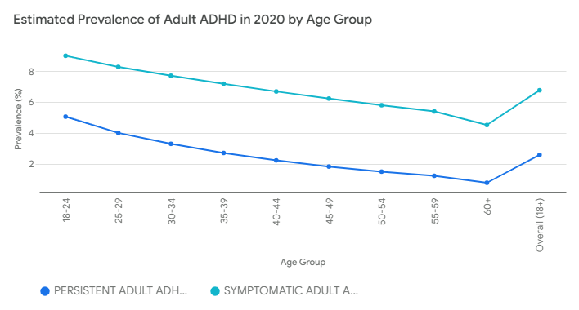
Adult ADHD Prevalence Decreases with Advancing Age (Song)
Song P, Zha M, Yang Q, Zhang Y, Li X, Rudan I. The prevalence of adult attention-deficit hyperactivity disorder: A global systematic review and meta-analysis. J Glob Health. 2021;11:04009. doi:10.7189/jogh.11.04009

Slide 11
ADHD Risk Factors
Preterm
Personal History of:
  Anxiety and Mood/Affective Disorders
  Oppositional defiant d/o or conduct disorder
  Epilepsy
  Autism Spectrum Disorder
  Learning disability
  Substance use disorder
  Traumatic Brain Injury
  Involvement with the criminal justice system
Family history of ADHD
Overview | Attention deficit hyperactivity disorder: diagnosis and management | Guidance | NICE. March 14, 2018. Accessed February 8, 2025. https://www.nice.org.uk/guidance/ng87

Slide 12
Diagnostic Approach

Slide 13
ADHD Inattention Symptoms (Summarized)- Adults need 5 of 9 symptoms
A- Sub-criteria | Description
a | Careless mistakes, lacks attention to detail.
b | Difficulty sustaining attention.
c | Doesn't seem to listen.
d | Fails to follow through on tasks.
e | Difficulty organizing tasks and activities.
f | Avoids tasks requiring sustained mental effort.
g | Loses necessary items.
h | Easily distracted.
i | Forgetful in daily activities.
Neurodevelopmental Disorders. In: Diagnostic and Statistical Manual of Mental Disorders. DSM Library. American Psychiatric Association Publishing; 2022. doi:10.1176/appi.books.9780890425787.x01_Neurodevelopmental_Disorders

Slide 14
ADHD Hyperactivity and Impulsivity Symptoms (Summarized)- Adults need 5 of 9 symptoms
A- Sub-criteria | Description
a | Fidgets, taps, squirms.
b | Leaves seat inappropriately.
c | Runs or climbs inappropriately (restless in adults).
d | Difficulty playing quietly.
e | "On the go," driven by a motor.
f | Talks excessively.
g | Blurts out answers.
h | Difficulty waiting turn.
i | Interrupts or intrudes on others.
Neurodevelopmental Disorders. In: Diagnostic and Statistical Manual of Mental Disorders. DSM Library. American Psychiatric Association Publishing; 2022. doi:10.1176/appi.books.9780890425787.x01_Neurodevelopmental_Disorders

Slide 15
ADHD Additional Criteria (Summarized)
Criteria | Description
B | “Several” symptoms present before age 12. [3 or more symptoms]
C | Symptoms present in two or more settings.
D | Symptoms interfere with functioning.
E | Symptoms not due to another disorder (e.g., mood disorder, anxiety disorder, dissociative disorder, personality disorder, substance intoxication or withdrawal).
F 90.8- Other Specified Attention-Deficit/Hyperactivity Disorder
Neurodevelopmental Disorders. In: Diagnostic and Statistical Manual of Mental Disorders. DSM Library. American Psychiatric Association Publishing; 2022. doi:10.1176/appi.books.9780890425787.x01_Neurodevelopmental_Disorders

Slide 16
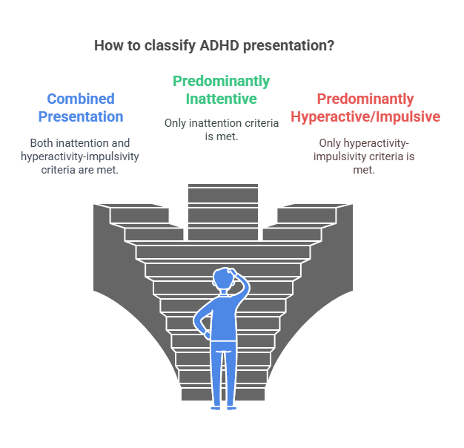
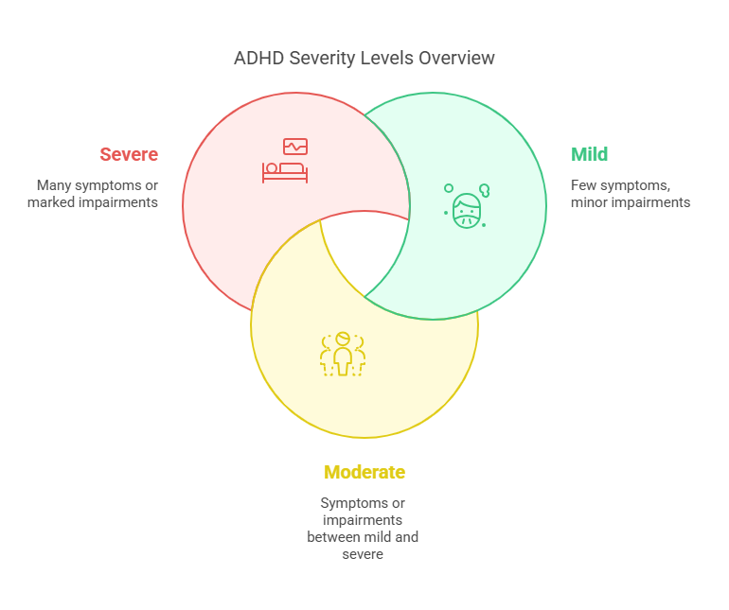
Classification and Severity Levels
Neurodevelopmental Disorders. In: Diagnostic and Statistical Manual of Mental Disorders. DSM Library. American Psychiatric Association Publishing; 2022. doi:10.1176/appi.books.9780890425787.x01_Neurodevelopmental_Disorders
Images generated with napkin.ai

Slide 17
Diagnosis in Primary Care Setting
Clinical Interview
Collateral information
Scales
  ASRS v1.1: Expected prevalence: 7%
  GAD-7 for anxiety
  PHQ-9 for depression
Medical concerns i.e. Fetal alcohol spectrum d/o, thyroid dz, sleep apnea, iatrogenic etc.
Note:
  Role of psych testing– limited! There is no magical neuropsych tests to specifically diagnose ADHD (though an entire industry exists)
  No technological test for adults at the moment
  Positive Response to stimulant/Rx challenge should not be used to diagnose ADHD
Overview | Attention deficit hyperactivity disorder: diagnosis and management | Guidance | NICE. March 14, 2018. Accessed February 8, 2025. https://www.nice.org.uk/guidance/ng87
Overview | Digital technologies for assessing attention deficit hyperactivity disorder (ADHD) | Guidance | NICE. October 21, 2024. Accessed February 8, 2025. https://www.nice.org.uk/guidance/dg60

Slide 18
ASRS-v 1.1
A cut-off of 4 positive areas (shaded) was previously used.
A numerical cut-off may be more useful (0-72).
The post-test probability of a disease depends on its prevalence in a given population (pre-test probability).
We will use the numerical cut-offs based on pre-test probability.
Kessler RC, Adler LA, Gruber MJ, Sarawate CA, Spencer T, Van Brunt DL. Validity of the World Health Organization Adult ADHD Self‐Report Scale (ASRS) Screener in a representative sample of health plan members. Int J Methods Psych Res. 2007;16(2):52-65. doi:10.1002/mpr.208

Slide 19
ASRS-v 1.1 Scores and Posterior Probabilities (7% prevalence)
ASRS Screener Cut-Off | Sensitivity (%) | Specificity (%) | +LR | -LR | Pos. Test Post Prob. | Neg. Test Post Prob.
49 | 45% | 98% | 22.5 | 0.56 | 62% | 4%
42 | 64% | 95% | 12.8 | 0.38 | 49% | 3%
36 | 79% | 90% | 7.9 | 0.23 | 37% | 2%
30 | 88% | 80% | 4.4 | 0.15 | 25% | 1%
27 | 90% | 71% | 3.10 | 0.14 | 19% | 1%
21 | 95% | 45% | 1.73 | 0.11 | 12% | 1%
16 | 98% | 22% | 1.26 | 0.09 | 9% | 1%
Kessler RC, Adler LA, Gruber MJ, Sarawate CA, Spencer T, Van Brunt DL. Validity of the World Health Organization Adult ADHD Self‐Report Scale (ASRS) Screener in a representative sample of health plan members. Int J Methods Psych Res. 2007;16(2):52-65. doi:10.1002/mpr.208
Brevik EJ, Lundervold AJ, Haavik J, Posserud M. Validity and accuracy of the Adult Attention‐Deficit/Hyperactivity Disorder (ADHD) Self‐Report Scale (ASRS) and the Wender Utah Rating Scale (WURS) symptom checklists in discriminating between adults with and without ADHD. Brain and Behavior. 2020;10(6):e01605. doi:10.1002/brb3.1605
Probabilities calculated using the Fagan nomogram drawn with tool from http://araw.mede.uic.edu/cgi-bin/testcalc.pl

Slide 20
ASRS-v 1.1 Scores and Posterior Probabilities (50% prevalence)
ASRS Screener Cut-Off | Sensitivity (%) | Specificity (%) | +LR | -LR | Pos. Test Post Prob. | Neg. Test Post Prob.
49 | 45% | 98% | 22.5 | 0.56 | 96% | 35%
42 | 64% | 95% | 12.8 | 0.38 | 93% | 28%
36 | 79% | 90% | 7.9 | 0.23 | 89% | 19%
30 | 88% | 80% | 4.4 | 0.15 | 81% | 13%
27 | 90% | 71% | 3.10 | 0.14 | 76% | 12%
21 | 95% | 45% | 1.73 | 0.11 | 63% | 10%
16 | 98% | 22% | 1.26 | 0.09 | 56% | 8%
Kessler RC, Adler LA, Gruber MJ, Sarawate CA, Spencer T, Van Brunt DL. Validity of the World Health Organization Adult ADHD Self‐Report Scale (ASRS) Screener in a representative sample of health plan members. Int J Methods Psych Res. 2007;16(2):52-65. doi:10.1002/mpr.208
Brevik EJ, Lundervold AJ, Haavik J, Posserud M. Validity and accuracy of the Adult Attention‐Deficit/Hyperactivity Disorder (ADHD) Self‐Report Scale (ASRS) and the Wender Utah Rating Scale (WURS) symptom checklists in discriminating between adults with and without ADHD. Brain and Behavior. 2020;10(6):e01605. doi:10.1002/brb3.1605
Probabilities calculated using the Fagan nomogram drawn with tool from http://araw.mede.uic.edu/cgi-bin/testcalc.pl

Slide 21
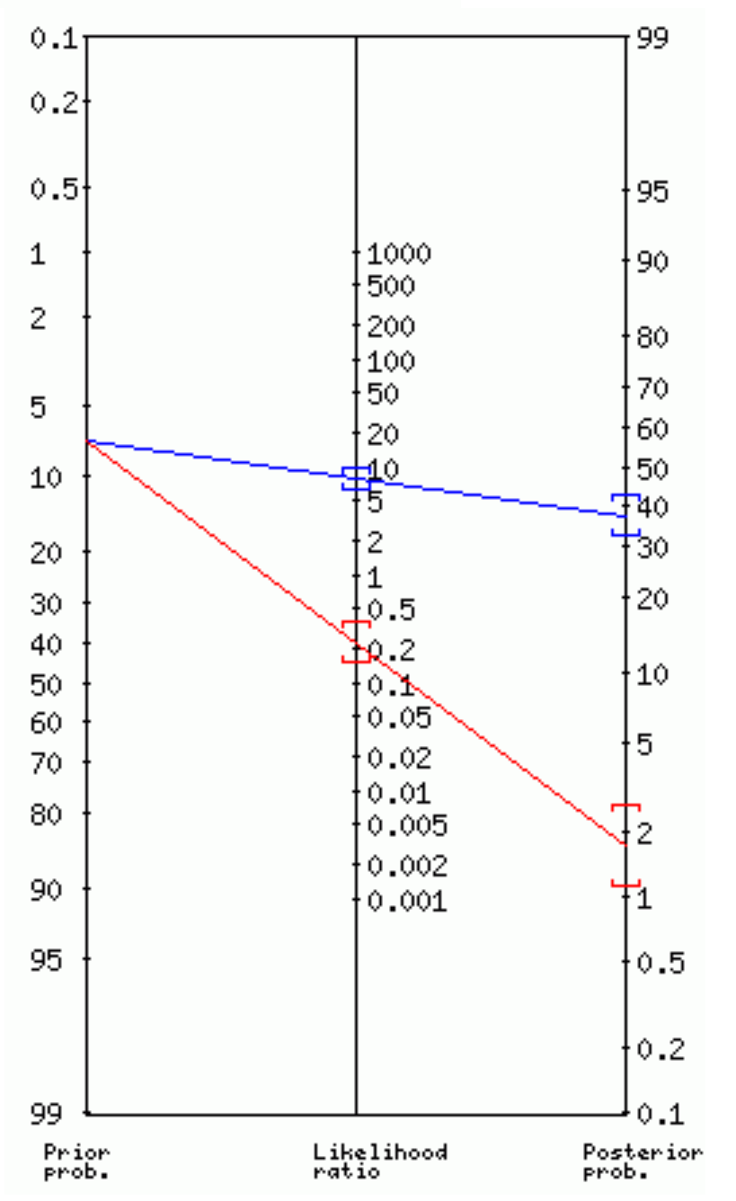
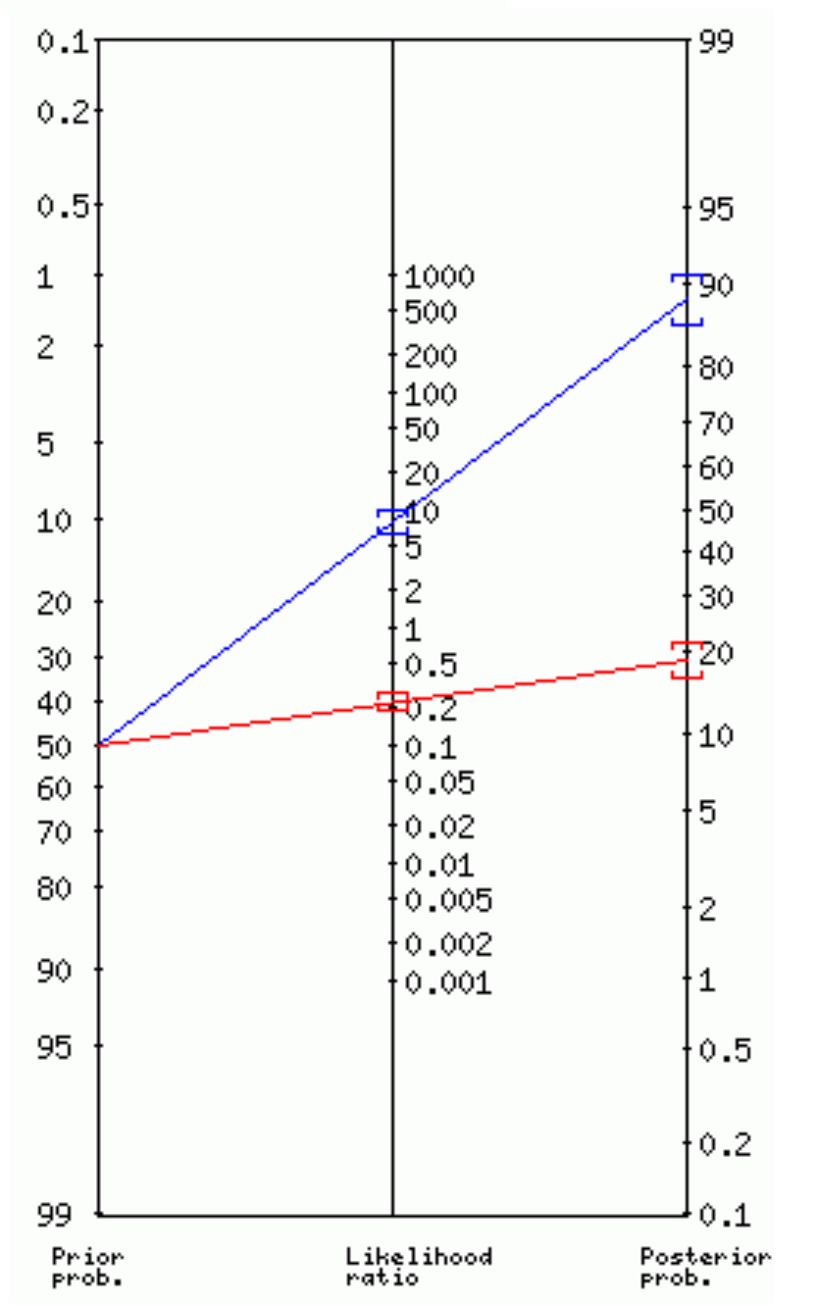
ASRS-v 1.1 Performance Depends on Pre-Test Probability (Cut-off 36)
Prior Prob: 7%
Prior Prob: 50%
+ Family Hx
+Poor academic or occupational performance
+ Collateral data
Absence of alternative dx i.e. anxiety
Brevik EJ, Lundervold AJ, Haavik J, Posserud M. Validity and accuracy of the Adult Attention‐Deficit/Hyperactivity Disorder (ADHD) Self‐Report Scale (ASRS) and the Wender Utah Rating Scale (WURS) symptom checklists in discriminating between adults with and without ADHD. Brain and Behavior. 2020;10(6):e01605. doi:10.1002/brb3.1605
Fagan nomogram drawn with tool from http://araw.mede.uic.edu/cgi-bin/testcalc.pl

Slide 22
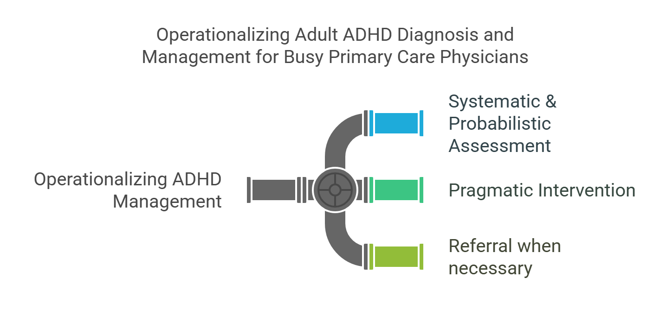

Slide 23
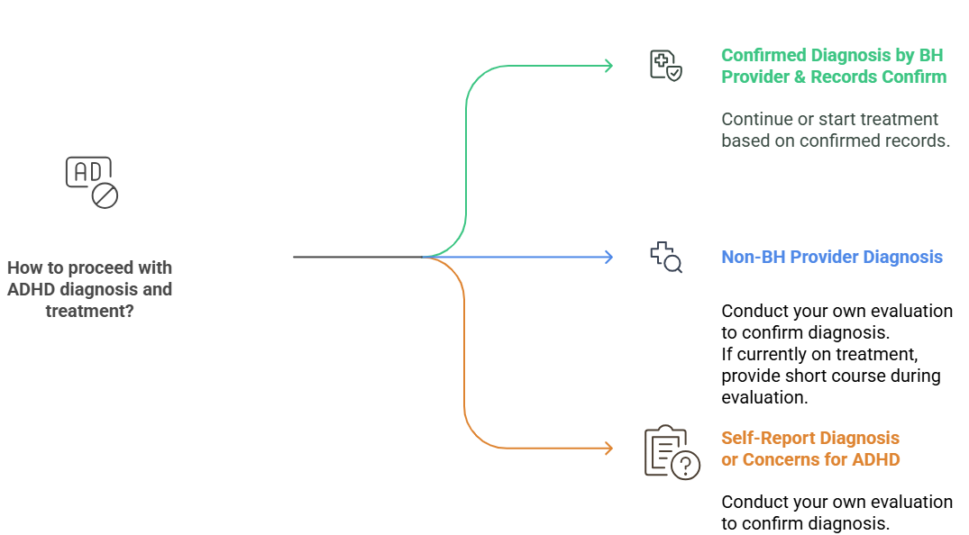
Pragmatic Diagnostic Journey

Slide 24


I’d rather have everyone see behavioral health providers for evaluation and/or treatment of ADHD.
Sure! Systems-Based Practice applies to ADHD. It would all depend on resources within your region and systems of health care delivery.

Slide 25
Primary Care ADHD Evaluation Packet
Rule-Out Adult ADHD & Screen Depression/Anxiety
A. Screeners: Initial Appointment- Administer and Analyze
  ASRS v1.1
  GAD-7
  PHQ-9
B. Personal & Collateral Packet: Initial appointment, provide to the patient, analyze in the second appointment
  ADHD Risk History Form
  Current Symptoms Scale- Self-Report
  Childhood Symptoms Scale- Self-Report
  Medical Assessment Tool for Adults with ADHD
  Informant- Parent (x2)
  Informant- Partner/Friend (x2)
Obtain more information when unable to r/o Adult ADHD in the first appointment.
You will receive the above items as part of this presentation.

Slide 26
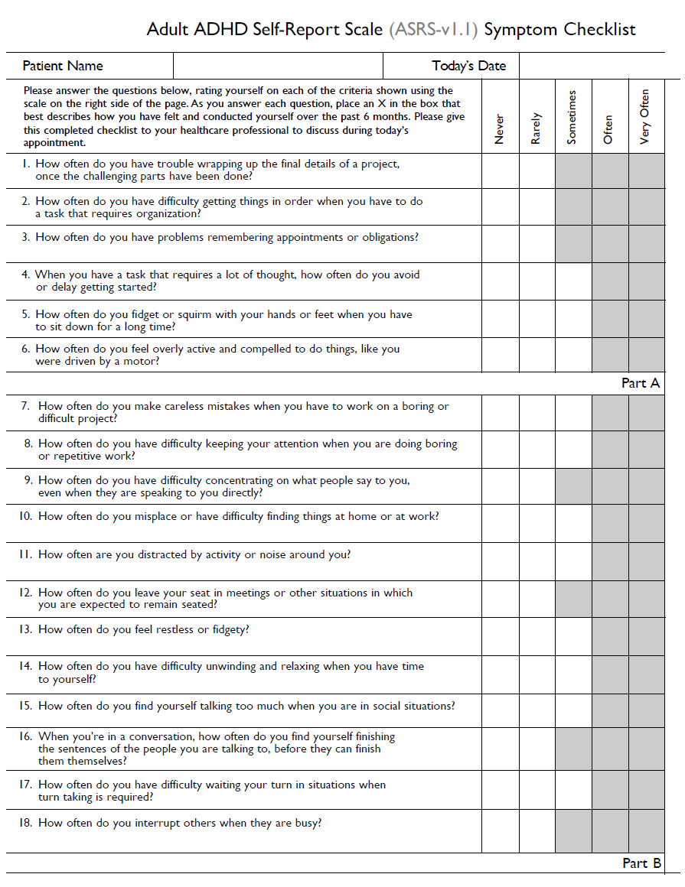
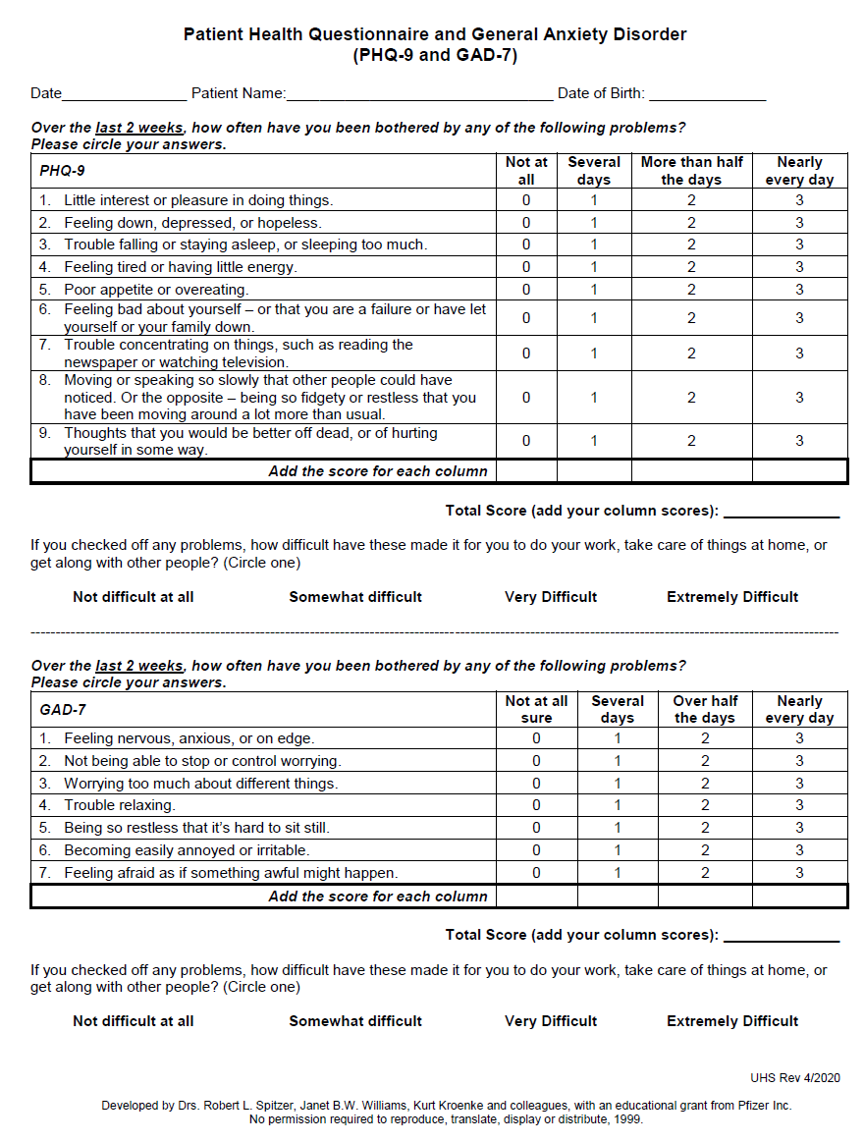
Screeners
Spitzer RL, Kroenke K, Williams JBW, Löwe B. A Brief Measure for Assessing Generalized Anxiety Disorder: The GAD-7. Arch Intern Med. 2006;166(10):1092. doi:10.1001/archinte.166.10.1092
Kroenke K, Spitzer RL, Williams JB. The PHQ-9: validity of a brief depression severity measure. J Gen Intern Med. 2001;16(9):606-613. doi:10.1046/j.1525-1497.2001.016009606.x

Slide 27
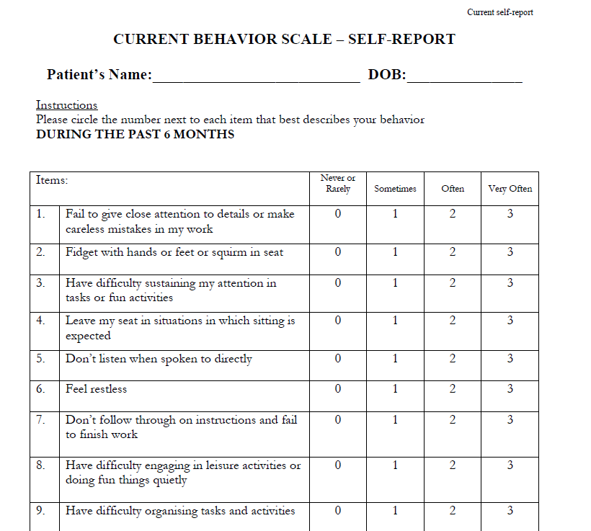
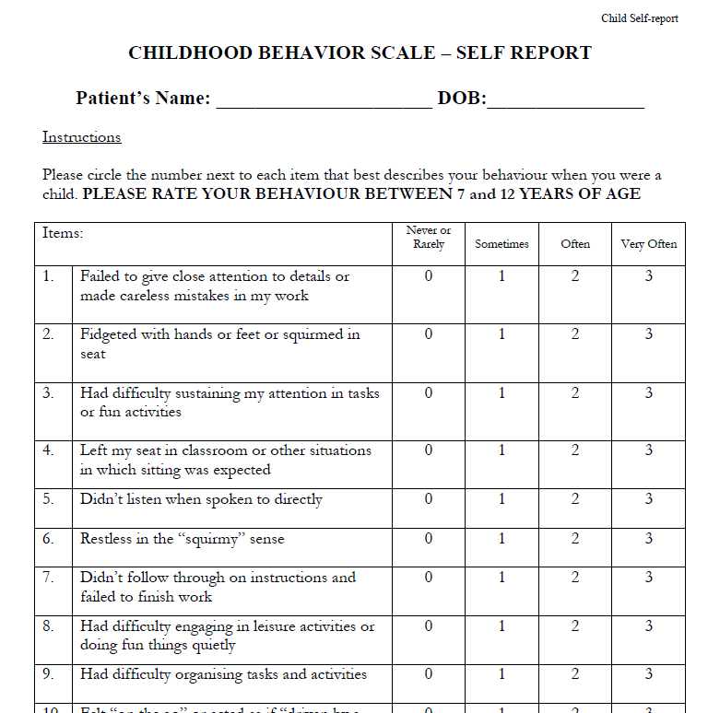
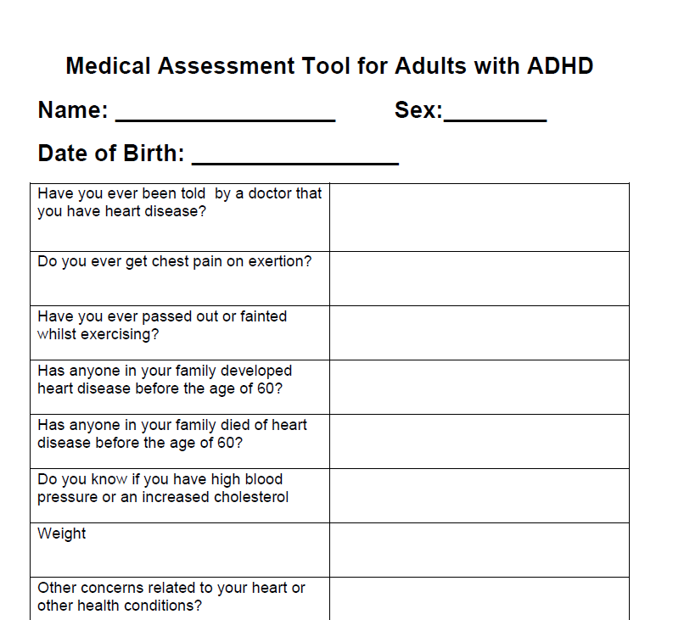
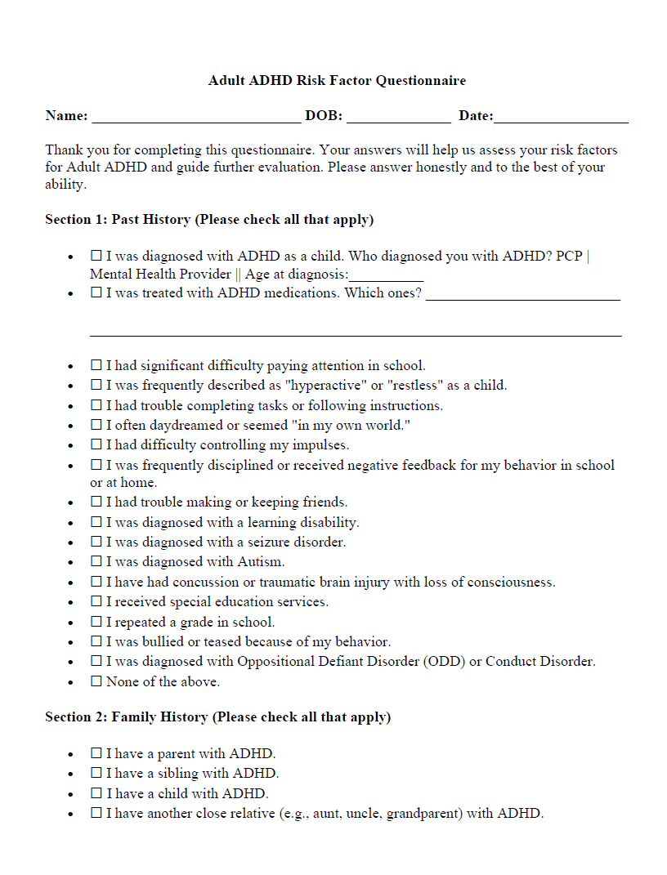
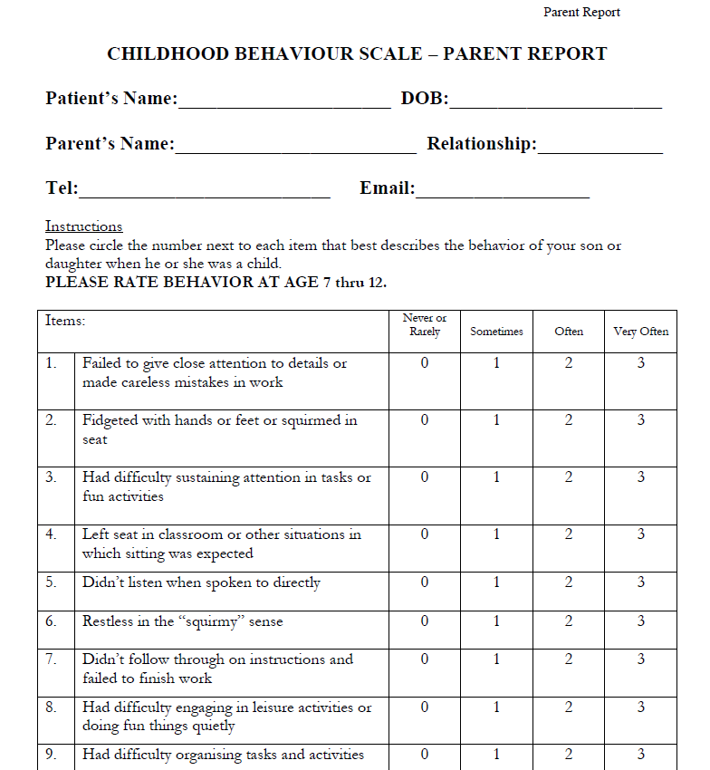
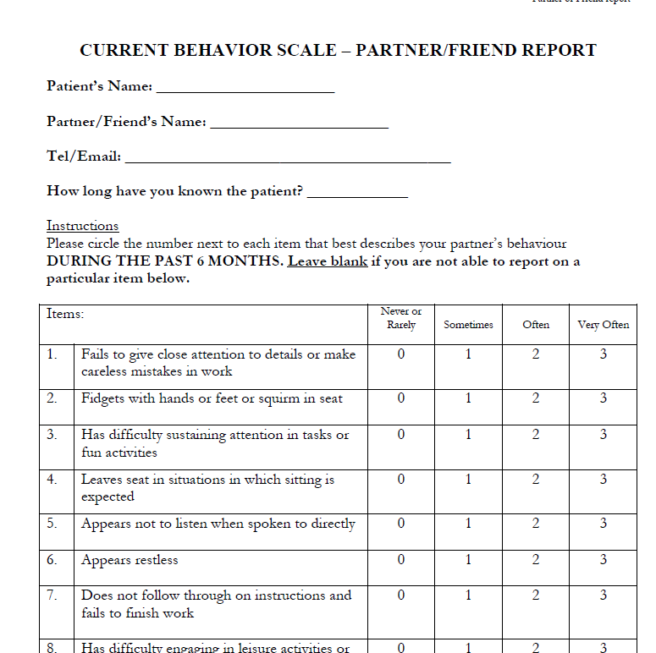
Collateral Packet
Adapted from: ADHD in adults - Good practice guidance CR235. www.rcpsych.ac.uk. Accessed February 15, 2025. https://www.rcpsych.ac.uk/improving-care/campaigning-for-better-mental-health-policy/college-reports/2023-college-reports/cr235

Slide 28
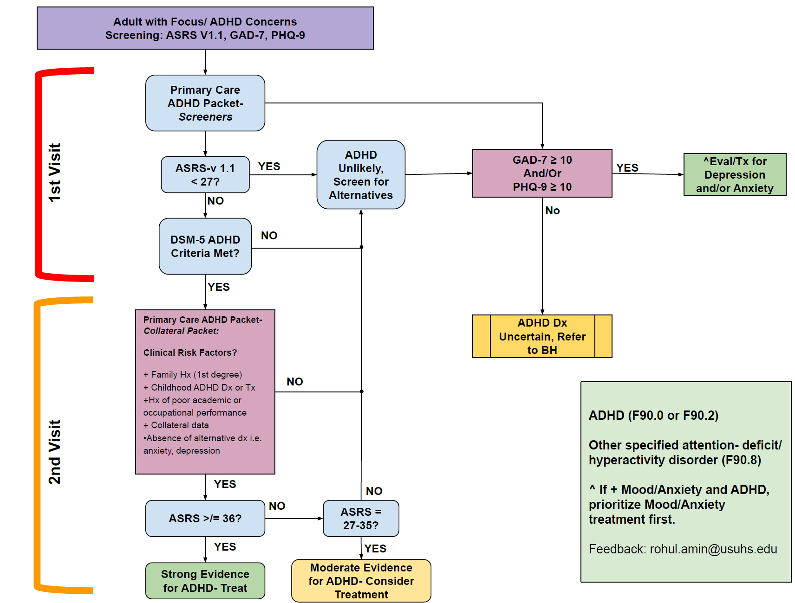

Slide 29
Alternative Explanations for ADHD-like Concerns
Perfectionism/Self-demanding
Defense against shortcomings and attribute to a medical diagnosis
Racing thoughts due to anxiety or fear – underlying anxiety or toxic leadership
Physical exhaustion from anxiety or depression resulting in not completing tasks
Task inertia due to fear of failure/shame
Procrastination or avoidance due to internalized overwhelming expectations
Iatrogenic
Malingering
Diagnosis:
  Generalized Anxiety Disorder
  Major Depressive Disorder
  Substance Use Disorders
  Avoidant and Obsessive-Compulsive Personality traits or disorders
Sibley MH. Empirically-informed guidelines for first-time adult ADHD diagnosis. J Clin Exp Neuropsychol. 2021;43(4):340-351. doi:10.1080/13803395.2021.1923665

Slide 30
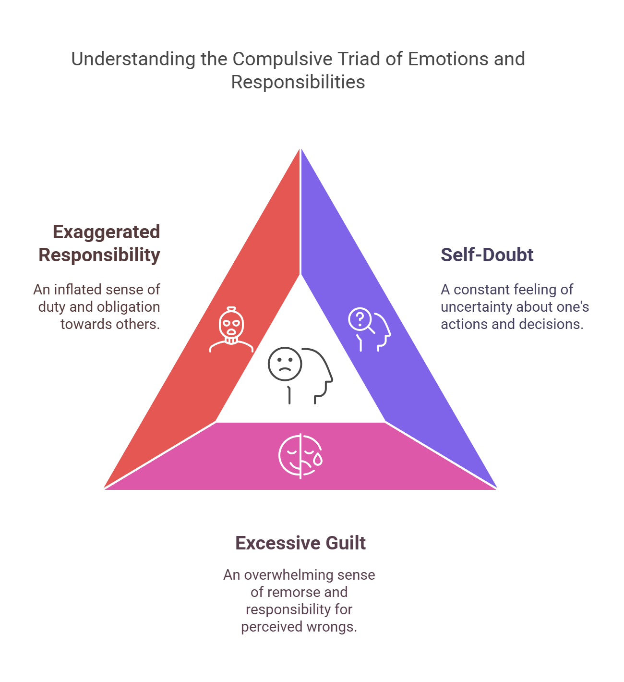
Perfectionism & Compulsiveness
Self-oriented perfectionism
  High standards for self
Others-oriented perfectionism
  Others must be perfect
Socially-oriented perfectionism
  I have to look perfect for others
  Imposter Syndrome
The role of compulsiveness in the normal physician - PubMed. Accessed February 15, 2025. https://pubmed-ncbi-nlm-nih-gov.usu01.idm.oclc.org/4057513/

Slide 31
Treating Adult ADHD

Slide 32
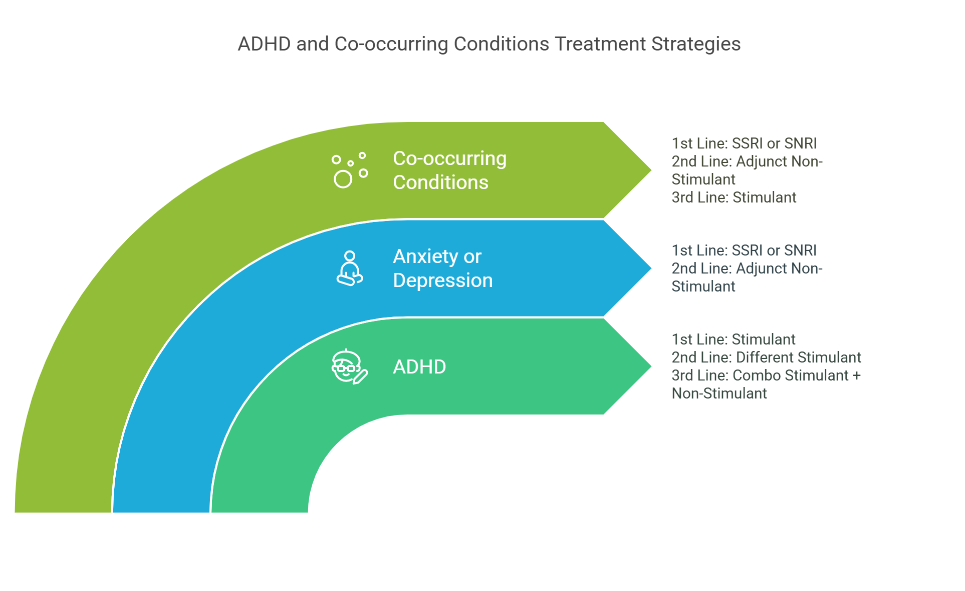
ADHD in adults - Good practice guidance CR235. www.rcpsych.ac.uk. Accessed February 15, 2025. https://www.rcpsych.ac.uk/improving-care/campaigning-for-better-mental-health-policy/college-reports/2023-college-reports/cr235

Slide 33
Patient Flow with Adult ADHD
Transition Patients
  Transition to adult medicine, ongoing treatment continuation
  50% children will transition to Adult ADHD treatment
Prior childhood diagnosis and treatment, re-referred for treatment
  Review records and determine if new diagnostic assessment is needed
New concern for Adult ADHD with no prior diagnosis or treatment
  New diagnostic assessment
ADHD in adults - Good practice guidance CR235. www.rcpsych.ac.uk. Accessed February 15, 2025. https://www.rcpsych.ac.uk/improving-care/campaigning-for-better-mental-health-policy/college-reports/2023-college-reports/cr235

Slide 34
When to Refer to Behavioral Health
Patient preference
Need for diagnostic clarification
Comorbid severe mental illness- bipolar, schizophrenia
Treatment resistant comorbid conditions
Substance Use Disorder
Lack of response to your interventions

Slide 35
ADHD Drug Effect Size & Tolerability in Adults
Drug | Standardized Mean Difference
Amphetamines | - 0.79 (-0.99 to -0.58)
Methylphenidate | -0.49 (-0.64 to -0.35)
Atomoxetine | -0.45 (-0.58 to -0.32)
Bupropion | -0.46 (-0.85 to -0.07)
Clonidine | -0.71 (-1.17 to -0.24) [Adolescents]
Guanfacine | -0.67 (-0.85 to -0.50) [Adolescents]
Modafinil | No different than placebo in adults
TOLERABILITY
Bupropion > Atomoxetine > Methylphenidate > Amphetamines
Cortese S, Adamo N, Del Giovane C, et al. Comparative efficacy and tolerability of medications for attention-deficit hyperactivity disorder in children, adolescents, and adults: a systematic review and network meta-analysis. The Lancet Psychiatry. 2018;5(9):727-738. doi:10.1016/S2215-0366(18)30269-4
Cortese S. Evidence-based prescribing of medications for ADHD: where are we in 2023? Expert Opinion on Pharmacotherapy. 2023;24(4):425-434. doi:10.1080/14656566.2023.2169604

Slide 36
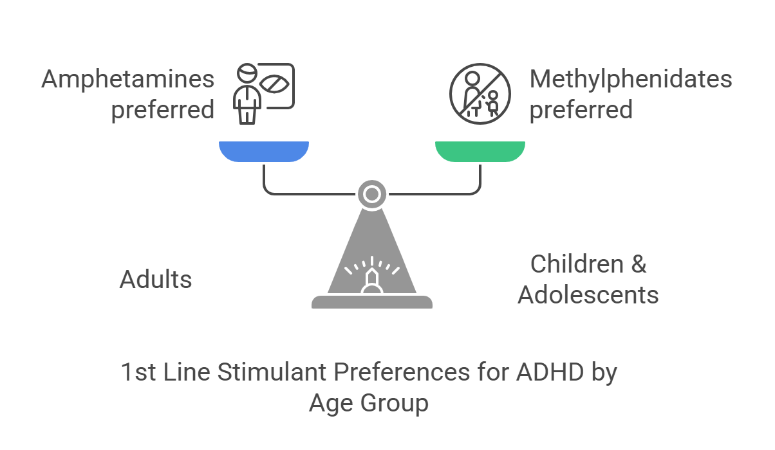
Cortese S, Adamo N, Del Giovane C, et al. Comparative efficacy and tolerability of medications for attention-deficit hyperactivity disorder in children, adolescents, and adults: a systematic review and network meta-analysis. The Lancet Psychiatry. 2018;5(9):727-738. doi:10.1016/S2215-0366(18)30269-4
Cortese S. Evidence-based prescribing of medications for ADHD: where are we in 2023? Expert Opinion on Pharmacotherapy. 2023;24(4):425-434. doi:10.1080/14656566.2023.2169604
Overview | Attention deficit hyperactivity disorder: diagnosis and management | Guidance | NICE. March 14, 2018. Accessed February 8, 2025. https://www.nice.org.uk/guidance/ng87

Slide 37
Drug Class | Brand Name | Generic Name | Dose Ranges (General) | Action Duration | Release (% Immediate vs. Slow) | Adults Approved
Amphetamine and Related Drugs
 | Adderall | Amphetamine/ Dextroamphetamine | 5-30 mg (IR), 5-30 mg (XR) | 4-6 | 100% instant | Yes
 | Adderall XR | Amphetamine/ Dextroamphetamine | 5-30 mg | 8-12 | 50% instant, 50% slow | Yes
 | Adzenys ER | Amphetamine | 3.1-18.8 mg | 11-13 | 30% instant, 70% slow | Yes
 | Adzenys XR-ODT | Amphetamine | 3.1-18.8 mg | 11-13 | 30% instant, 70% slow | Yes
 | Dexedrine | Dextroamphetamine | 2.5-30 mg (IR), 5-15 mg (Spansules) | 4-6 | 100% instant | Yes
 | Dyanavel XR | Amphetamine | 2.5-20 mg (tablets), 2.5-10 mg/mL (oral suspension) | 11-13 | 30% instant, 70% slow | Yes
 | Evekeo | Amphetamine | 5-20 mg (tablets), 5-15 mg (ODT) | 9-12 | 100% instant | Yes
 | Evekeo ODT | Amphetamine | 5-20 mg | 9-12 | 100% instant | Yes
 | Mydayis | Amphetamine/ Dextroamphetamine | 12.5-50 mg | 10-16 | 33% instant, 67% slow | Yes
 | Vyvanse | Lisdexamfetamine | 10-70 mg | 10-13 | 0% instant, 100% slow (prodrug) | Yes
 | Xelstrym | Dextroamphetamine | 10-30 mg (transdermal patch) | 12 | 100% slow (transdermal) | Yes
 | Zenzedi | Dextroamphetamine | 2.5-30 mg | 10-12 | 100% instant | Yes
Reference Slide

Slide 38
Drug Class | Brand Name | Generic Name | Dose Ranges (General) | Action Duration | Release (% Immediate vs. Slow) | Adults Approved
Methylphenidate
 | Adhansia XR | Methylphenidate | 25-85 mg | 12-16 | 20% instant, 80% slow | Yes
 | Aptensio XR | Methylphenidate | 10-60 mg | 12 | 40% instant, 60% slow | Yes
 | Azstarys | Serdexmethylphenidate/ Dexmethylphenidate | 26.1/5.2 mg - 52.3/10.4 mg | 12 | 30% instant, 70% slow | Yes
 | Concerta | Methylphenidate | 18-72 mg | 3-6 (immediate), 12 (extended) | 22% instant, 78% slow | Yes
 | Cotempla XR-ODT | Methylphenidate | 8.6-25.9 mg | 10-12 | 25% instant, 75% slow | No
 | Daytrana | Methylphenidate | 10-30 mg (transdermal patch) | 3-4 (patch on), 3-4 (after removal) | 100% slow (transdermal) | Yes
 | Focalin | Dexmethylphenidate | 2.5-10 mg | 2-4 | 100% instant | Yes
 | Focalin XR | Dexmethylphenidate | 5-40 mg | 8-12 | 50% instant, 50% slow | Yes
 | Jornay PM | Methylphenidate | 20-100 mg | 13 | 0% instant, 100% slow | Yes
 | Metadate CD | Methylphenidate | 10-60 mg | 6-8 | 30% instant, 70% slow | Yes
 | Metadate ER | Methylphenidate | 20 mg | 8 | 100% instant | Yes
 | Methylin ER | Methylphenidate | 10-20 mg | 8 | 100% instant | Yes
 | Methylin Oral Solution | Methylphenidate | 5 mg/5 mL | 2-4 | 100% instant | Yes
 | QuilliChew ER | Methylphenidate | 20-40 mg | 5-9 | 30% instant, 70% slow | Yes
 | Quillivant XR | Methylphenidate | 25 mg/5 mL | 9-11 | 20% instant, 80% slow | Yes
 | Relexxi | Methylphenidate | 10-60 mg | 12 | 100% instant | Yes
 | Ritalin | Methylphenidate | 5-20 mg | 2-4 | 100% instant | Yes
 | Ritalin LA | Methylphenidate | 10-60 mg | 3-4 immediate, 8-9 extended | 50% instant, 50% slow | Yes
Reference Slide

Slide 39
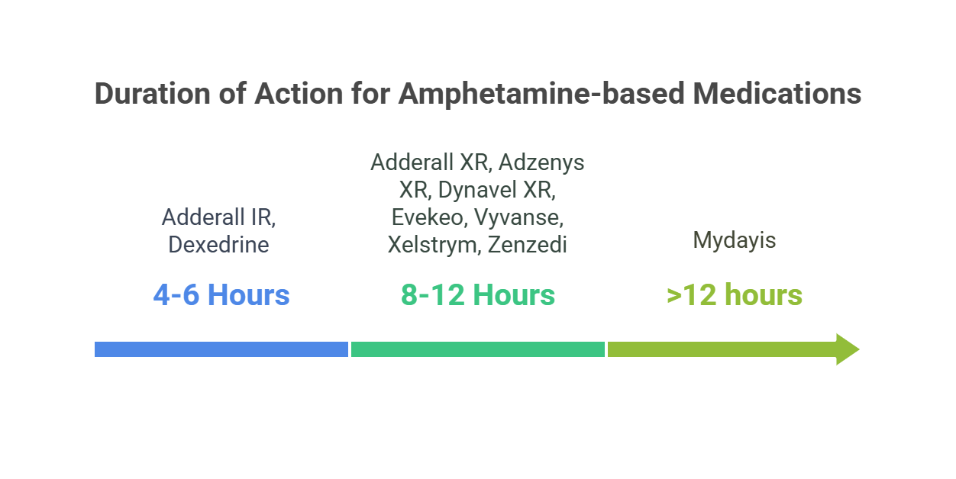

Slide 40
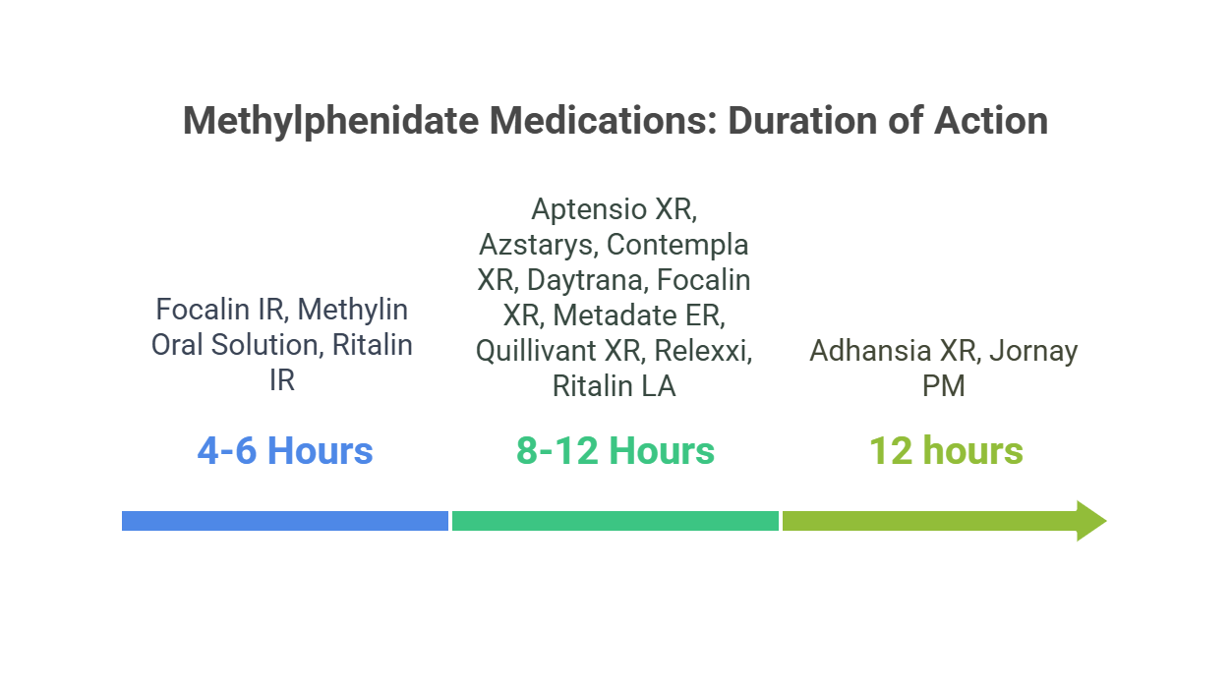

Slide 41
Generics as of Feb 2025
Amphetamines | Methylphenidates | Non-Stimulants
Adderall IR and XR | Aptensio | Pamelor (off-label)
Dexedrine | Concerta | Wellbutrin SR and XL (off-label)
Vyvanse | Focalin IR and XR | Strattera
 | Metadate | Kavpay (clonidine) (off-label in adults)
 | Ritalin | Intuniv (Guanfacine XR) (Off-label in adults)

Slide 42
Cardiovascular Concerns
Known increase in heart rate, measure q6 months
Possible increase in blood pressure, measure q6 months
Use the Medical Assessment Tool for Adults with ADHD to screen for these issues
No need for routine ECG in population without cardiovascular risk/concerns
Stimulants may worsen peripheral vascular disease
Cardiology referral if risk for structural or electrophysiological concerns
ADHD in adults - Good practice guidance CR235. www.rcpsych.ac.uk. Accessed February 15, 2025. https://www.rcpsych.ac.uk/improving-care/campaigning-for-better-mental-health-policy/college-reports/2023-college-reports/cr235

Slide 43
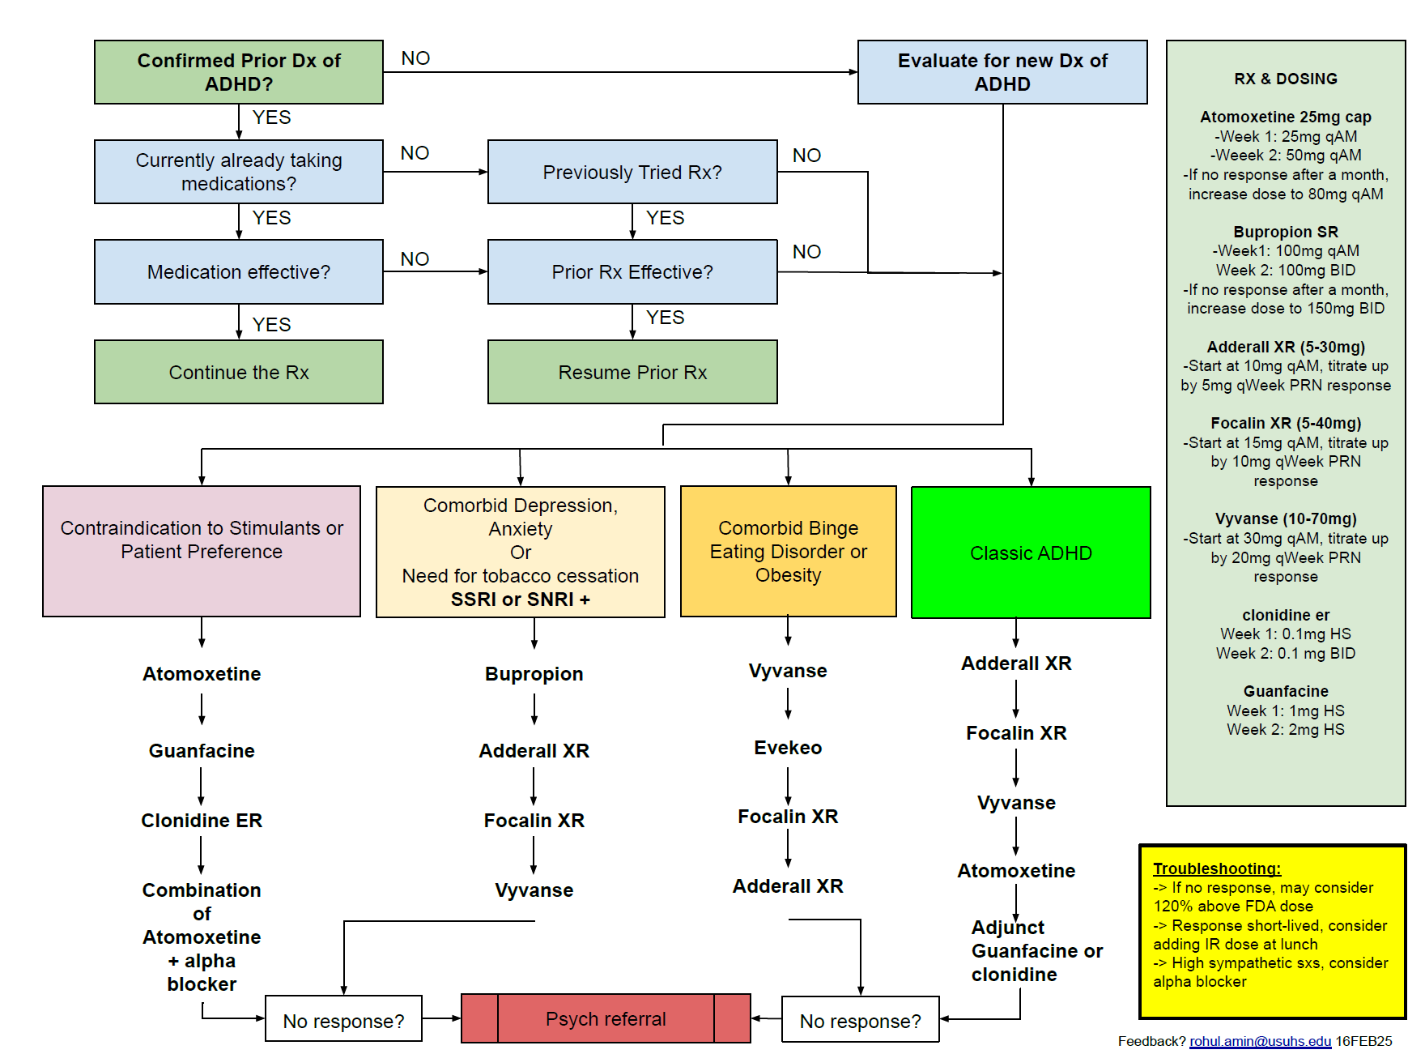
ADHD Management in Primary Care
Cortese S, Adamo N, Del Giovane C, et al. Comparative efficacy and tolerability of medications for attention-deficit hyperactivity disorder in children, adolescents, and adults: a systematic review and network meta-analysis. The Lancet Psychiatry. 2018;5(9):727-738. doi:10.1016/S2215-0366(18)30269-4
Cortese S. Evidence-based prescribing of medications for ADHD: where are we in 2023? Expert Opinion on Pharmacotherapy. 2023;24(4):425-434. doi:10.1080/14656566.2023.2169604
Overview | Attention deficit hyperactivity disorder: diagnosis and management | Guidance | NICE. March 14, 2018. Accessed February 8, 2025. https://www.nice.org.uk/guidance/ng87
ADHD in adults - Good practice guidance CR235. www.rcpsych.ac.uk. Accessed February 15, 2025. https://www.rcpsych.ac.uk/improving-care/campaigning-for-better-mental-health-policy/college-reports/2023-college-reports/cr235

Slide 44
Non-Pharmacological Interventions
Patient’s choice
Adherence issues
Intolerance or clinical contraindications to pharmacological treatment
Only mild symptoms
Concerns for abuse or diversion
Adjunct to pharmacological treatment in treatment-resistant cases
Behavioral interventions are inferior to stimulant therapies
  CBT
  Organizational coaching focused on executive coaching
  Technology- reminders etc.
ADHD in adults - Good practice guidance CR235. www.rcpsych.ac.uk. Accessed February 15, 2025. https://www.rcpsych.ac.uk/improving-care/campaigning-for-better-mental-health-policy/college-reports/2023-college-reports/cr235

Slide 45
Troubleshooting Issues
Anxiety or irritability: reduce dose, switch to a methylphenidate or non-stimulant
Insomnia: earlier administration, switch to drug with a shorter duration of action
Symptoms towards the latter part of the day: switch to longer duration drug or add IR in the afternoon (1pm to 2pm)
Motor tics: reduce the dose, or switch to another stimulant or non-stimulant
Psychosis or mania: discontinue and refer to psychiatry
Unintended weight loss: switch to a methylphenidate or non-stimulant, or take with/after meals
Only partial response: try other stimulants or add one of these as adjunct: bupropion, atomoxetine, clonidine or guanfacine
Diversion or abuse prevention: controlled substance agreement, baseline urine drug screen and random future UDS in the agreement, prescription drug monitoring data

Slide 46
Misuse and Diversion Detection and Prevention
Prescription Stimulant Misuse (PSM) is about 5.6% among high school and 10.3% among college students.
Avoid being rushed into ordering a prescription. There is no ADHD treatment emergency!
The diagnostic process (ritual) is tedious but can also act as a way to ensure appropriate motivation on part of the patient exists.
Collateral input (using the packet provided) is important for good diagnostic assessment.
Controlled Substance Agreement is a must! (template copy provided to you)
Check PDMP database every time. No early refills!
Q3 month visit for new scripts.
Urine Drug Screen on initiating and then once a year.
No tool exists for prediction PSM or diversion. Consider Opioid Risk Tool (ORT) which has universal risk factors for opioids/narcotics. If High Risk, low quantity or non-stimulant Rx.
Webster LR. Risk Factors for Opioid-Use Disorder and Overdose. Anesth Analg. 2017;125(5):1741-1748. doi:10.1213/ANE.0000000000002496
Schepis TS, Buckner JD, Klare DL, Wade LR, Benedetto N. Predicting College Student Prescription Stimulant Misuse: An Analysis from Ecological Momentary Assessment. Experimental and clinical psychopharmacology. 2020;29(6):580. doi:10.1037/pha0000386

Slide 47
Summary

Slide 48
Summary
Have systems and processes in place
Prior diagnosis and treatment- determine validity of prior evaluation and act accordingly
New diagnosis: split the diagnosis over 2 appointments and get collateral using the packet of forms provided today while following the algorithm
Management: If depression or anxiety or equally likely to cause the dysfunction, treat those first and then initiate treatment for ADHD. Use the algorithm provided as a starting point.
When selecting medications, dose and titration schedules, consider psychosocial circumstances such as untreated ADHD threatening academic or professional standing
Outcomes: Use self-report on ASRS v1.1 and subjective report
Safety: Use the Medical Assessment Tool for Adults with ADHD form to screen for any contraindications for stimulants. Obtain a signed Controlled Substance Agreement, baseline Urine Drug Screen (UDS), and random UDS per local resources, check PDMP

Slide 49
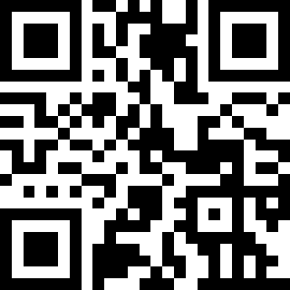
Deliverables
https://tinyurl.com/acpadultadhd

Slide 50

Discussion
Q&A
"The good physician treats the disease; the great physician treats the patient who has the disease.“ –Sir William Osler

